Slide 1

Status and perspectives of solid state photon detectors
Sergey Vinogradov
P.N. Lebedev Physical Institute of the Russian Academy of Sciences, Moscow, Russia
Division of Solid State Physics
    National Research Nuclear University «MEPhI», Moscow, Russia
    Laboratory of Silicon Photomultipliers

Slide 2
Scope & outline
  Photon detection and Solid State Photon Detectors (SSPD)
  Cherenkov light detection challenges
  Silicon Photomultiplier (SiPM)
    Concept
    Physics
    Designs
  SSPD / SiPM performance overview
  Photon number / energy resolution
  Time resolution
  Spatial resolution
    Position sensitive SiPM
    Digital SiPM / SPAD Arrays
  Perspectives of solid state photon detectors

Slide 3
Cherenkov light detection challenge
Cherenkov light pulse detection objectives:
  Number of photons in the pulse
  Time of arrival (TOF) of the pulse
  Spatial distribution of the light
Cherenkov detection demands to photon detector:
  Photon number resolution – starting from single photons
  Time resolution – pico-…nanosecond range
  Spatial resolution – (micro-?)… mm range
Ideally, we prefer the highest precision
in measuring #photons in time and space
In fact, Cherenkov detection is
an ultimate challenge for photon detectors
Images
Photons
E. Fossum, Sensors, 2016

Slide 4
Why Solid State Photon Detectors?
Advantages of solid state (semiconductor) photodetectors
  High photon detection efficiency (PDE) due to internal photoemission
    For good photon number resolution
  Fast timing due to µm-scale thickness of sensitive layers
    For good time resolution
  Scalable active areas in µm – mm range due to solid state technology
    for good spatial resolution
  Solid state technology
Trade-offs
  Fast timing => high electronic noise
  ~ 10K electrons @ 1 GHz BW
  => multiplication with gain > 10K
  for single photon detection => APD
  High gain APD =>
  high excess noise of avalanche
  no photon number resolution
New kind of APD with high gain, low noise, fast timing is required:
Solid State / Silicon Photomultiplier (SSPM / SiPM)
W. Farr, SPIE LEOS 2009

Slide 5
SiPM: concept, physics, designs. developments
SiPM/SSPM: concept, physics, designs. developments

Slide 6
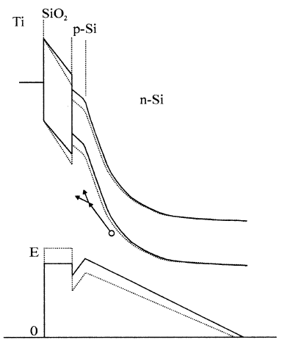
SiPM concept:
Basic studies at Lebedev Physical Institute (1970s-1990s)
Avalanche with Negative Feedback (ANF) concept:
  Strong positive feedback: avalanche development as fast as possible
  → Geiger mode avalanche breakdown with high overvoltage
  Strong negative feedback: avalanche quenching as fast as possible
  → Passive quenching by built-in elements (ANF or NAF APD)
  Capacitive (feedback ~ avalanche charge)
  Resistive (feedback ~ avalanche current)
ANF
=>
High gain
+
Low noise
+
Fast time
V. Shubin, D. Shushakov, Encyclopedia of Optical Engineering 2003; DOI: 10.1081/E-EOE 120009727

Slide 7
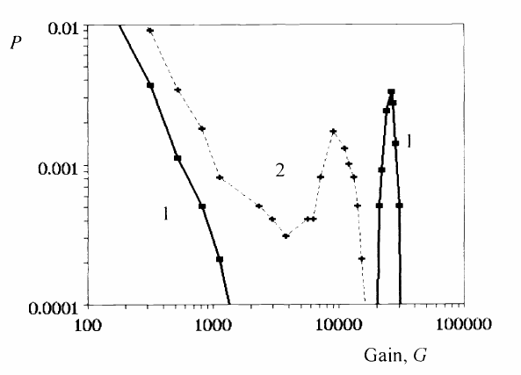
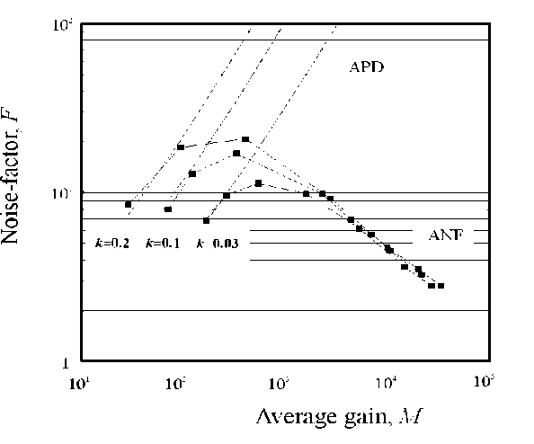
SiPM physics: model of single-electron ANF process
Distribution of single electron Gain Excess Noise Factor of Gain
Gain vs Overvoltage ANF process time
D. Shushakov, V. Shubin, New Solid State Photomultiplier, SPIE (1995)

Slide 8
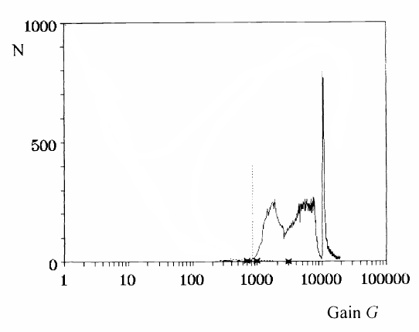
SiPM physics: experiment on single-electron ANF process
Simulated distribution of single electron Gain
A few photon pulse detection by charge sensitive preamp
Experimental histograms of single photoelectron Gain
1 phe
Pedestal
D. Shushakov, V. Shubin, New Solid State Photomultiplier, SPIE (1995)

Slide 9
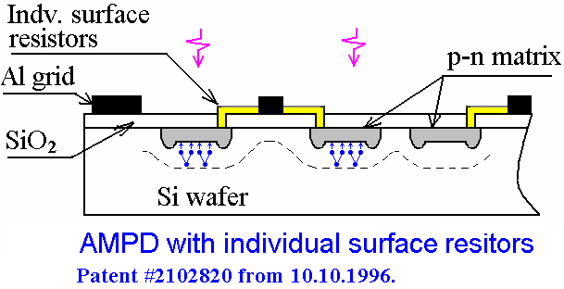
SiPM designs:
Basic developments (1988-1998)
MOS APD (1970s-1980s)
Planar MRS APD (1988)
MRS APD with trenches (1998)
Key developers:
Z. Sadygov (INR, JINR)
V. Golovin (MELZ, CPTA)
Needle MRS APD (1989)
Z. Sadygov, NDIP 2005, 2008; ICASiPM 2018

Slide 10
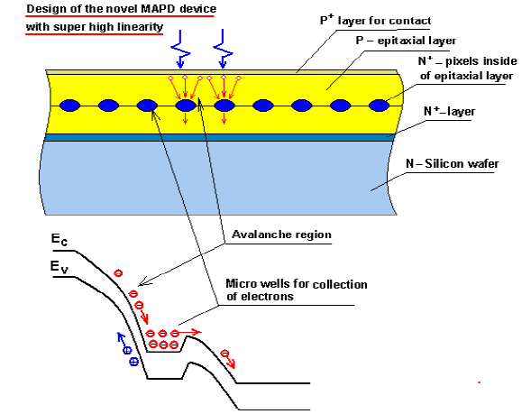
SiPM designs:
Advanced developments (2000s)
MOS APD (1970s-1980s)
Micropixel APD, Z. Sadygov et al., JINR / Zecotek, NDIP 2005
SiPM, B. Dolgoshein et al., MEPhI / Pulsar, 2000-2003
SSPM, V. Golovin et al., CPTA / Photonique, NDIP 2008

Slide 11
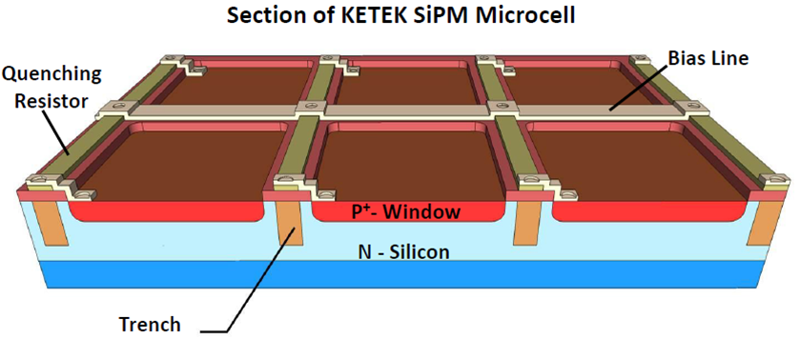
Modern SiPMs
SiPM/SSPM – a new generation of photon-number-resolving SSPDs
Analog SiPM/SSPM – an array of APD cells with individual quenching resistors and common readout independently operated in a limited Geiger mode
Alternative SiPM designs: Micropixel APDs, SiPMs with bulk-quenching…
Convergence of SiPM technology and SPAD arrays with active quenching of CMOS technology: digital SiPM, multi-digital SiPM, 3D SiPM…
KETEK SiPM – custom technology STMicroelectronics SiPM – CMOS technology

Slide 12
SiPM: performance
SiPM/SSPM: performance in photon number resolution

Slide 13
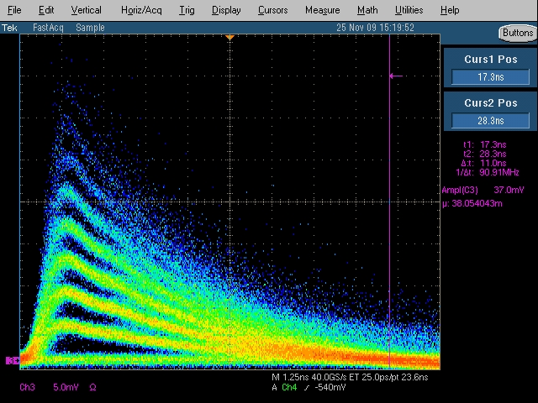
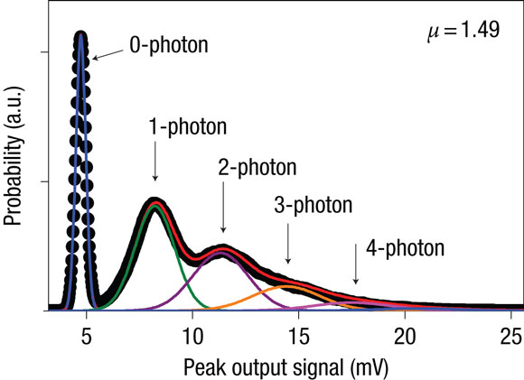
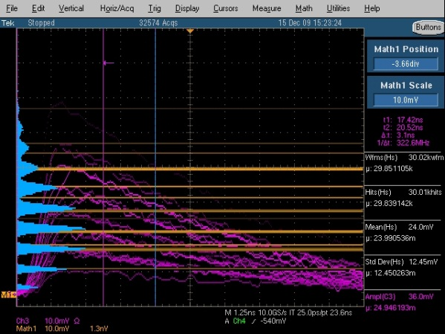
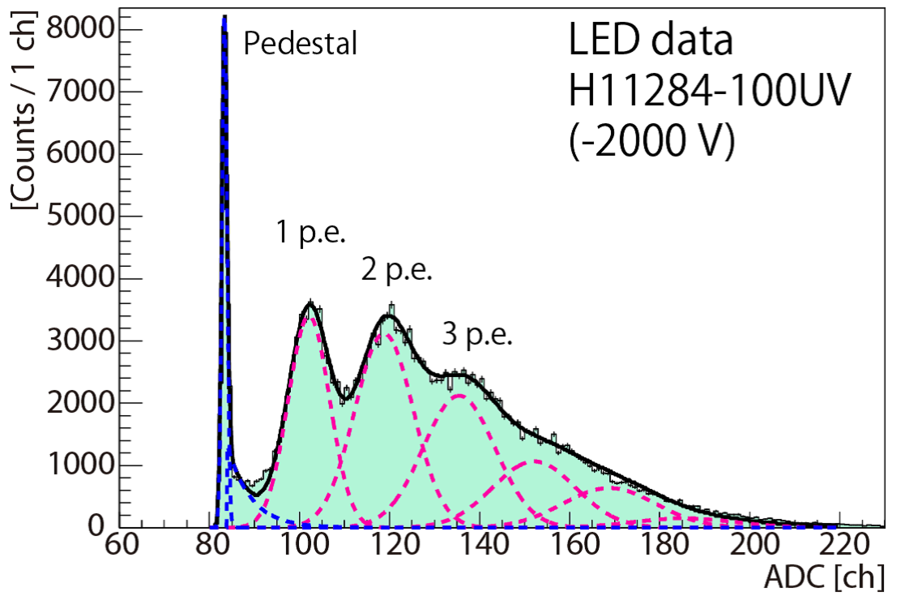
SiPM: photon number resolution
APD (self-differencing mode)
SiPM (Hamamatsu MPPC)
SiPM (MEPhI/Pulsar)
Charge integration
B. Kardinal et al., Nat. Photonics, 2008
APD QE ~ 80% SiPM PDE ~ 30%
R. Mirzoyan et al., NDIP, 2008
PMT (Hamamatsu H11284-100UV)
SiPM (Hamamatsu MPPC)
SiPM (Excelitas by MPI/MEPhI license)
PMT QE ~ 30%
Charge histogram
T. Cogami et al, Water Cherenkov detector, NIMA 2016
S. Vinogradov, SPIE 2017
A. Barlow and J. Schilz, SiPM matching event, CERN, 2011

Slide 14
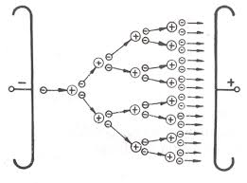
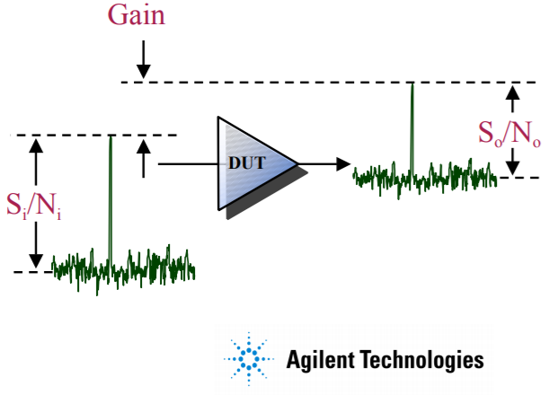
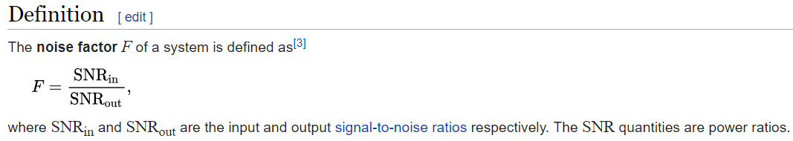
Excess noise factor (ENF) as a measure of noisiness of multipliers and amplifiers
ENF in multipliers (APD, PMT, SiPM):
ENF in amplifiers:
1 electron → M electrons
High ENF
Low ENF
Noise factor (F) measures degradation of the signal-to-noise ratio (SNR), caused by components in a signal chain.

Slide 15
Resolution of photon detection:
Excess Noise Factor approach^{[1]}
  Output RES defined by input RES degraded due to a photodetection processes with specific ENFs
Process j
ENFj
RES(Y_{out})
RES(X_{in})
Process i
ENFi
Input photon distribution Photodetection processes Output charge distribution
[1] S. Vinogradov et al., “Efficiency of Solid State Photomultipliers in Photon Number Resolution,” IEEE Trans. Nucl. Sci., 2011.
[2] S. Vinogradov, “Analytical models of probability distribution and excess noise factor of solid state photomultiplier signals with crosstalk,” NIMA 2012.

Slide 16
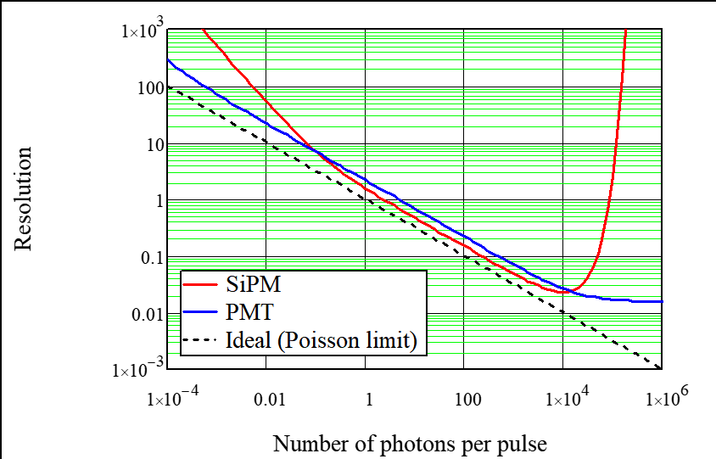
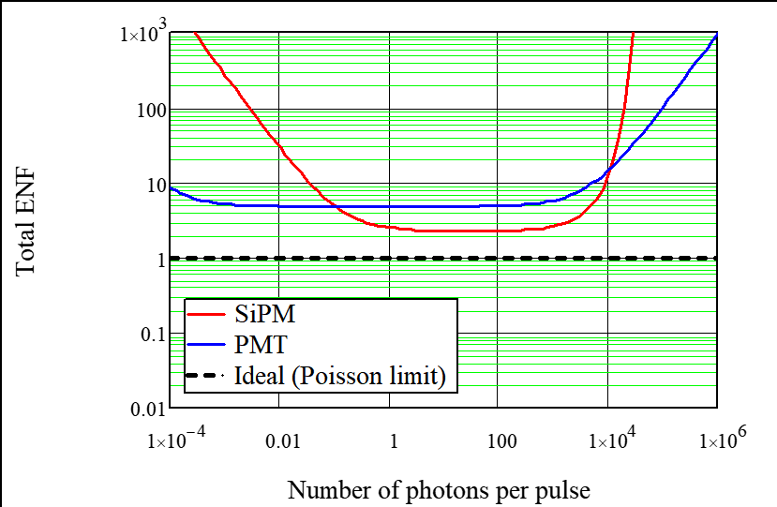
Key SiPM parameters in ENF metrics

Slide 17
Resolution, total ENF, and
Detective Quantum Efficiency (DQE)
DCR
Max DQE
Npix, Trecov

Slide 18
Performance of photodetectors in DQE
Optimal detection
Detective Range
Electronic & Dark noise
Nonlinearity
Saturation
Optimal DQE

Slide 19
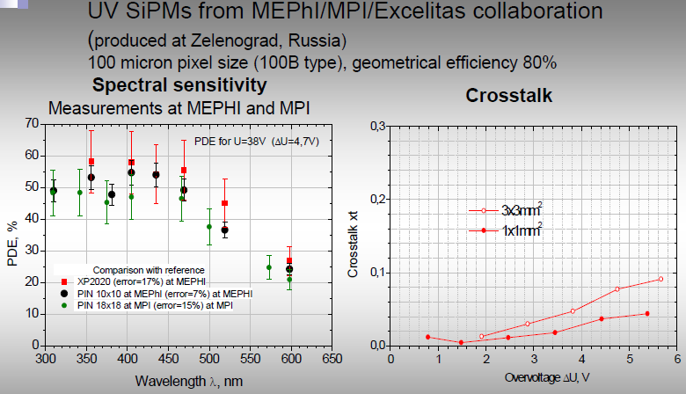
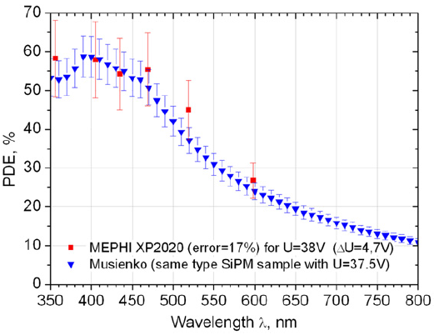
The highest max DQE ~ 55% (2011)
PDE ~ 58%, Crosstalk ~ 4%
E. Popova et al., NDIP 2011

Slide 20
Highest DQE of market SiPMs (2014)
(2014)
Optimal DQE
Short light pulse detection (T_{pulse} < T_{dead}), binomial nonlinearity
S. Vinogradov, 2nd Advanced SiPM Workshop, CTA, Geneva, 2014

Slide 21
DQE trade-offs: PDE vs Crosstalk vs Dynamic Range
(2014)
100um: high PDE=37% but high Pct=35%
10um: high Dynamic Range but low PDE=10% & low Cpix
low Gain → electronic noise
Short light pulse detection (T_{pulse} < T_{dead}), binomial nonlinearity
S. Vinogradov, 2nd Advanced SiPM Workshop, CTA, Geneva, 2014

Slide 22
DQE trade-off: PDE vs Crosstalk vs Dynamic Range
General: High PDE = QE · Pav_trig · Fill Factor (with QE, Pav_trig → 90%)
Direction 1: Large pixels (50…75 um) with high fill factor and max suppression of crosstalk (metal-filled trenches and more). Max priority – high DQE for low photons. Low Dynamic range as is.
Direction 2: Small pixels (5…15 um) with low crosstalk due to low gain (low capacitance) and fast recovery (low capacitance). Max priority – high Dynamic range. DQE as high as possible (no trenches, narrow pixel borders for higher fill factor)
Crosstalk
DCR
Npix, Trecov
PDE

Slide 23
High PDE: QE · Pav_trig · Fill Factor

Slide 24
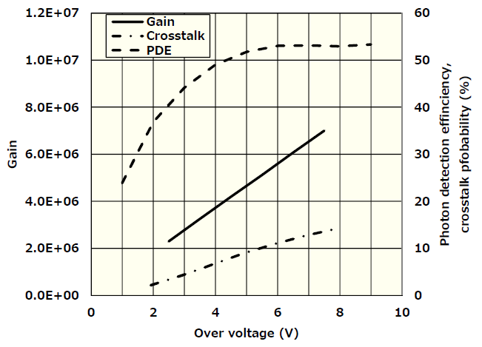
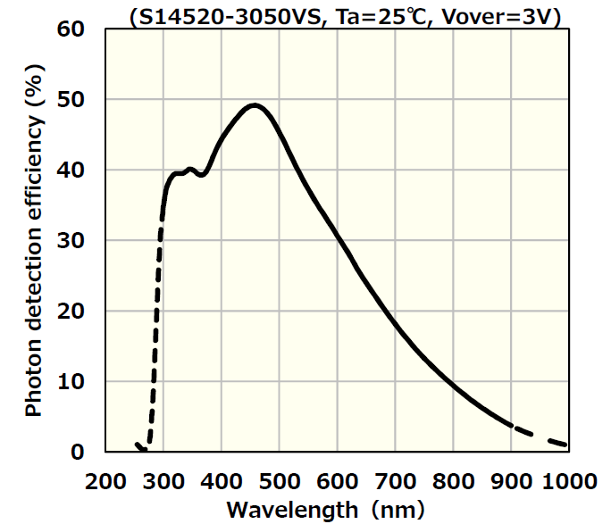
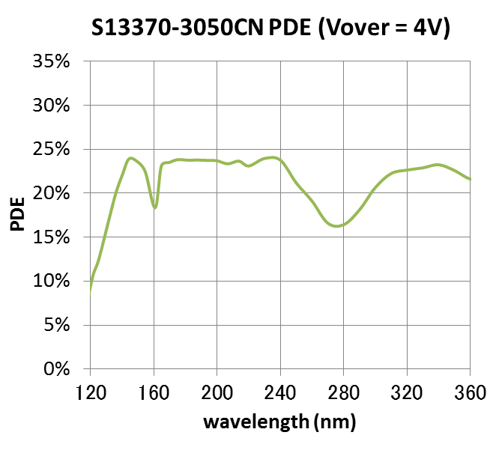
QE in UV: MPPC for Cherenkov and VUV detection
S14520 Series (50 um) – developed for Cherenkov Telescope Array
S13370 series – developed for VUV
Cryogenically reliable
Low optical crosstalk due to trenches
Fast recovery (stable Rq vs. temperature)

Slide 25
High PDE: QE · Pav_trig · Fill Factor
=> Pav_trig ~ 95%

Slide 26
High PDE: QE · Pav_trig · Fill Factor

Slide 27
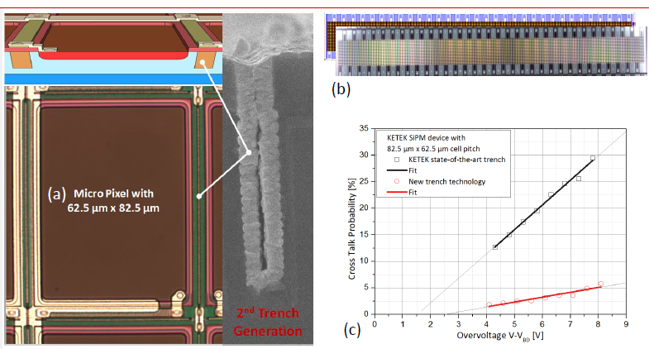
Large pixels with trenches: low crosstalk and high fill factor
F.Wiest NDIP2014

Slide 28
Small pixels with low gain: low crosstalk and high dynamic range
F.Acerbi, TREDI 2017

Slide 29
Highest DQE of modern SiPMs (2018)

Slide 30
SiPM: performance
SiPM/SSPM: performance in time resolution

Slide 31
SiPM time resolution
Delta-pulses - Single Photon Time Resolution (SPTR) (+ +)
  SiPM characterization; Time-Correlated Single-Photon Spectroscopy
Gaussian pulses of variable width (laser/LED) (+)
  LIDAR
Scintillation pulses – Coincidence Time Resolution (+ + +)
  TOF PET and more…
Arbitrary light waveforms – almost out of SiPM studies (-)
  Cherenkov Fiber Beam Loss Monitoring
$Aout\left(t\right)=\text{ρ}\text{ph}\text{(}\text{t}\text{)}∗\text{ρ}\text{sptr}\text{(}\text{t}\text{)}∗\text{ρ}\text{sec}\text{(}\text{t}\text{)}∗\text{h}\text{ser}\text{(}\text{t}\text{)}$
Leading edge
or
Constant fraction discriminator
Single-electron response (SER) shape
S. Vinogradov, NDIP 2014, NIMA 2015

Slide 32
Main trade-off: fast timing vs large area
Larger area => higher noise + slower response => lower TR
  DCR noise ~ area
  Electronic noise ~ capacitance ~ area
  Signal rising slope ~ SER rise time ~ capacitance
F.Acerbi, FAST 2014, NIMA 2015

Slide 33
Compensation of large capacitance by transformer

Slide 34
SPTR and CTR of modern SiPMs to be reconsidered

Slide 35
Strip SiPM with dual differential readout
K. Doroud et al, NIMA 2017

Slide 36
Performance of Strip SiPM
SPTR ~ 70 ps due to dual differential readout
  Typical SPTR of 3x3mm² SiPM ~ 200 ps
Position resolution by time delay encoding (50 ps) ~ 750 um
K. Doroud et al, NIMA 2017

Slide 37
SiPM: performance
SiPM/SSPM: approaches to high spatial resolution
    Position Sensitive SiPMs
    SPAD arrays
    Quantum Image Sensors

Slide 38
Position-Sensitive SiPM
D. Han, ICASiPM 2018

Slide 39
3x3mm² PS SiPM of Novel Device Lab (Beijing)
High position resolution (26…40 um)
High photon number resolution
D. Han, ICASiPM 2018

Slide 40
SPAD arrays trade-off: TDC multiplexing

Slide 41
SPAD arrays trade-off: PDE vs functionalities
J. F. Pratte et al., FAST 2014

Slide 42
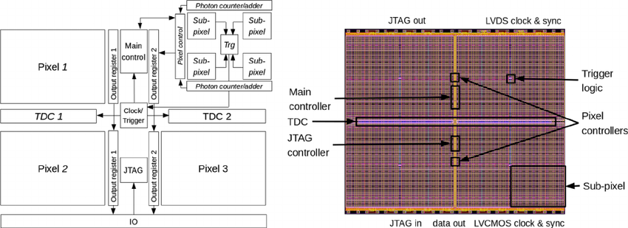
Digital SiPM
Philips digital photon counter
T. Frach et al., IEEE NSS/MIC 2009
Fill Factor ~ 50%
PDE ~ 30%
SPRT~ 85 ps for “pixel” of 3200 cells (3.2 x 3.9 mm²)
SPTR ~ 100 ps for SiPM of 4 “pixels”
Readout time = 327 µs

Slide 43
SPAD arrays: Multi-Digital SiPM and more…
Aqua Lab EPFL / TU Delft (Edoardo Charbon)
E. Charbon, FAST 2018

Slide 44
Performance of SPADs
E. Charbon, FAST 2018

Slide 45
3D SiPM (SPAD Array), Sherbrook University
J. F. Pratte et al., FAST 2014
F. Nolet et al., NDIP 2017
SPTR of single SPAD + TDC = 17.5 ps FWHM

Slide 46
Quantum Image Sensor: ultimate CMOS imager
Dartmouth College (Eric Fossum)
Size < 500 nm
Capacitance < 1 fF
Gain ~ 1mV/e
Noise < 0.15 e RMS
J. Ma et al., Photon-number-resolving megapixel image sensor at room temperature without avalanche gain, Optica 2017

Slide 47
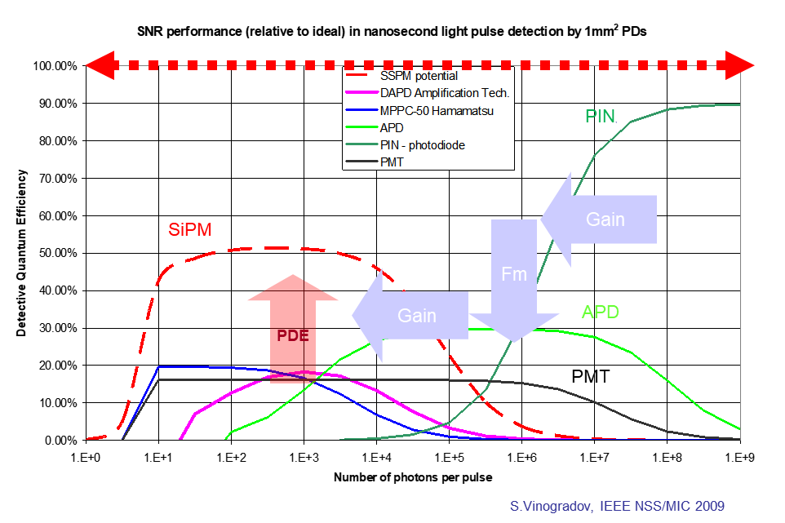
Summary
SiPM technology: breakthrough in photon detection
  Superior photon number resolution and time resolution
  Highly competitive in short (ps – ns range) pulse detection
  CMOS-compatible / mass production / low cost / reliable technology
  Position-sensitive SiPMs are promising as inexpensive imagers
  Fast progress in:
    PDE
    Dynamic range
    SPTR
    Non-silicon SSPM
      NIR
      UV
      RadHard
  Convergence of
    Analog SiPMs
    Digital SiPMs
    SPAD arrays
    3D SiPMs

Slide 48


Acknowledgements
This work was supported in part by EC under
Grant Agreement FP7 329100 “SiPM in-depth”
FAST (Fast Advanced Scintillation Timing) COST TD1401 action
“SENSE – a roadmap for the ideal low light level sensor development” Horizon 2020 FET-Open CSA project

Slide 49
The end
Thank you for your attention!
Questions?
Objections?
Opinions?
…
vin@lebedev.ru

Slide 51
SPAD arrays: Multi-Digital SiPM and more…
E. Charbon, FAST 2018

