Slide 1
Status of the accelerator conceptual design for Super Tau Charm Facility at China
Qing Luo
2019.09.26@Moscow
National Synchrotron Radiation Laboratory
University of Science and Technology of China

Slide 2
Outline
General Description
Accelerator Physics
  Lattice Design
  Polarization Issues
  Beam-beam
Accelerator Technologies
  Feedback
  Vacuum
  New Technologies, i.e. new type of magnets
Conclusions and Future Plans

Slide 3
General Description
Interaction Region: Large Piwinski Angle Collision
+Crabbed Waist
Detector
Snakes
Crab Sextupole
Injector
Wigglers
Linac
0.5-3.5
GeV
e+0.5GeV
e- 0.5GeV
About injector:
  For e+ and e-, no booster, 0.5GeV->1~3.5GeV
  e+, a convertor, a linac and a damping ring, 0.5GeV
  e-, a polarized e- source, accelerated to 0.5GeV

Slide 4
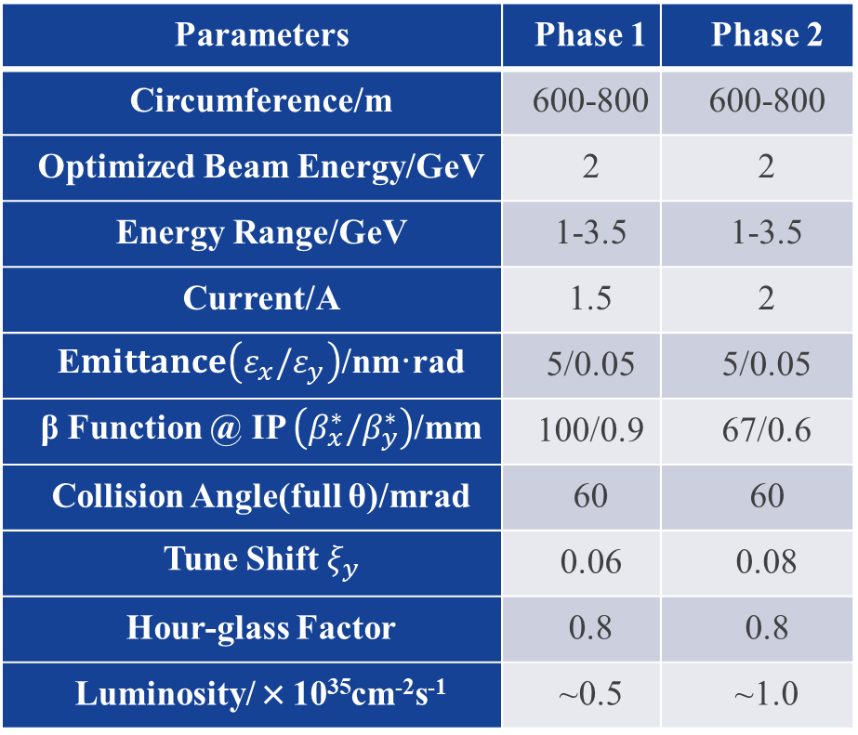
General Description: Project construction goal
Parameters | Phase 1 | Phase 2
Circumference/m | 600-800 | 600-800
Optimized Beam Energy/GeV | 2 | 2
Energy Range/GeV | 1-3.5 | 1-3.5
Current/A | 1.5 | 2
E$mittance\left(ε_{x}/ε_{y}\right)$/nm·rad | 5/0.05 | 5/0.05
β Function @ IP $\left({β_{x}^{∗}/β}_{y}^{∗}\right)$/mm | 100/0.9 | 67/0.6
Collision Angle(full θ)/mrad | 60 | 60
Tune Shift $ξ_{y}$ | 0.06 | 0.08
Hour-glass Factor | 0.8 | 0.8
Luminosity/×10³⁵cm⁻²s⁻¹ | ~0.5 | ~1.0

Slide 5
Accelerator Physics: Lattice Design
Comparison between lattice with FODO and MBA arc
  FODO type: weaker focusing, better nonlinearity and larger room for optimization, especially when beam energy and work point have been changed
  MBA type: stronger focusing, smaller ring with lower cost, may clear up more space for straight sections and polarization
Key Points
  -I transformation for nonlinearity cancellation
  -I transformation used both in arc section and IR
  Very weak nonlinearity in arc section
Notes:
Russia:ξ_{x} 0.0016, 0.0033, 0.0036, 0.0029; ξ_{y} 0.114, 0.135, 0.121, 0.097
per mille
Lattice functions not necessary to be totally symmetric in IR: INFN的设计是对称的，图只显示了一半；BINP original不对称，原因是几何结构决定必须有不同的聚焦（？），从简单做起，仍然先按对称来做

Slide 6
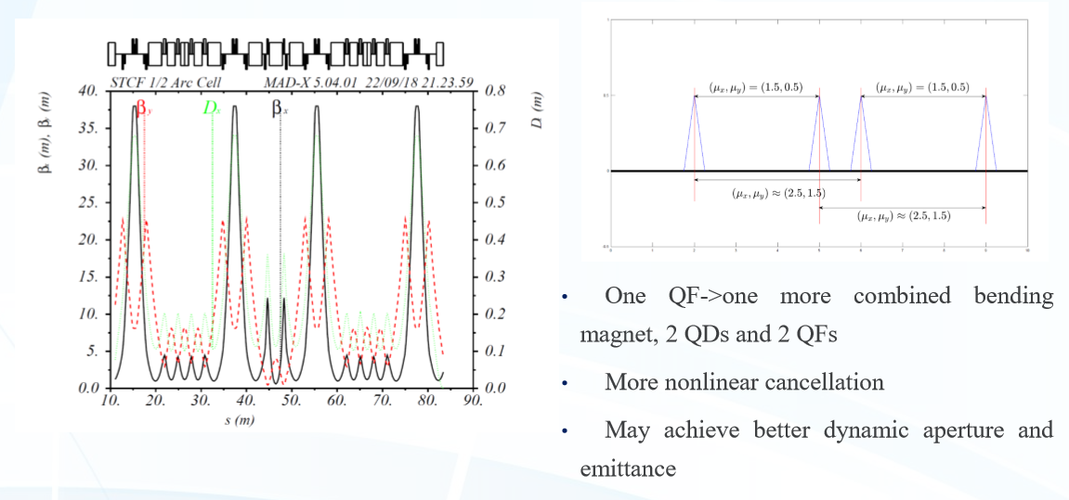
Lattice A: with MBA arc
Minor modification based on the Italian TCF design

Slide 7
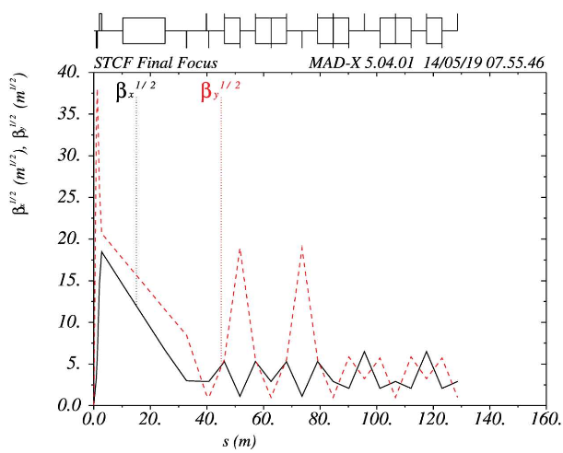
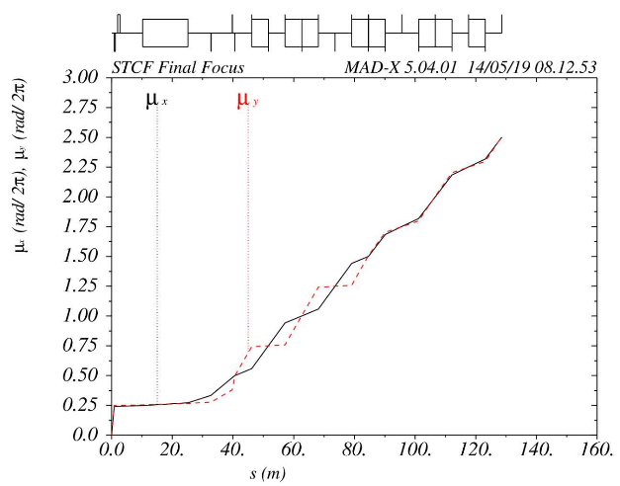
Lattice A: with MBA arc
The final focus section has a total length of 257.318m (without dispersion suppression section, not finished yet). The traditional scheme for chromatic correction is employed. The chromaticity is compensated in dedicated sections separately (CCY and CCX). A pair of sextupoles are placed in symmetrical high β function in each section, each pair is in phase with the final doublet. The geometric aberrations and the second order dispersion aberration are cancelled in each pair.

Slide 8
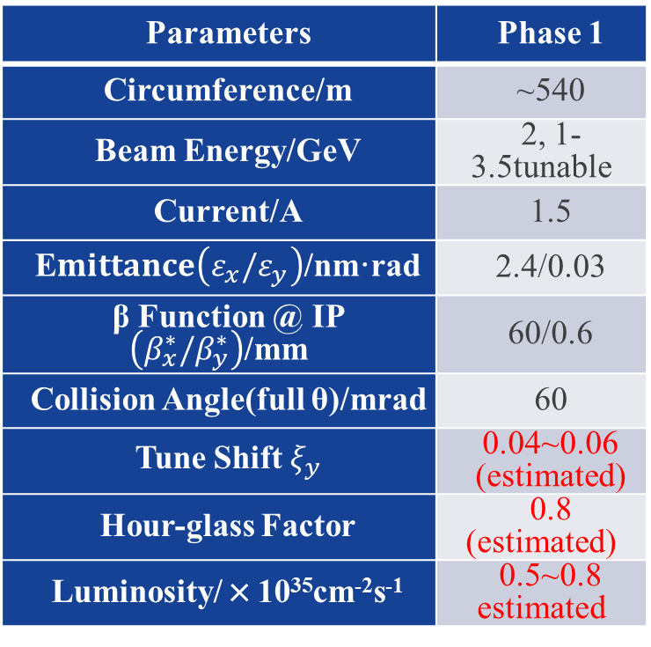
Lattice A: with MBA arc
Collider with MBA-based Arc
  Parameters now
Parameters | Phase 1
Circumference/m | ~540
Beam Energy/GeV | 2, 1-3.5tunable
Current/A | 1.5
E$mittance\left(ε_{x}/ε_{y}\right)$/nm·rad | 2.4/0.03
β Function @ IP $\left({β_{x}^{∗}/β}_{y}^{∗}\right)$/mm | 60/0.6
Collision Angle(full θ)/mrad | 60
Tune Shift $ξ_{y}$ | 0.04~0.06 (estimated)
Hour-glass Factor | 0.8 (estimated)
Luminosity/×10³⁵cm⁻²s⁻¹ | 0.5~0.8 estimated
Table left shows the rough and estimated machine parameters that we achieve at present. The nonlinear optimization is in progress while the study of the collective effects and beam-beam effect has not started yet, so the whole design may be greatly adjusted in future
Notes:
西伯利亚蛇：很贵，所以尽可能少。与能量有关（退极化与能量有关），能量很大的时候（例如3GeV）的确需要多个蛇

Slide 9
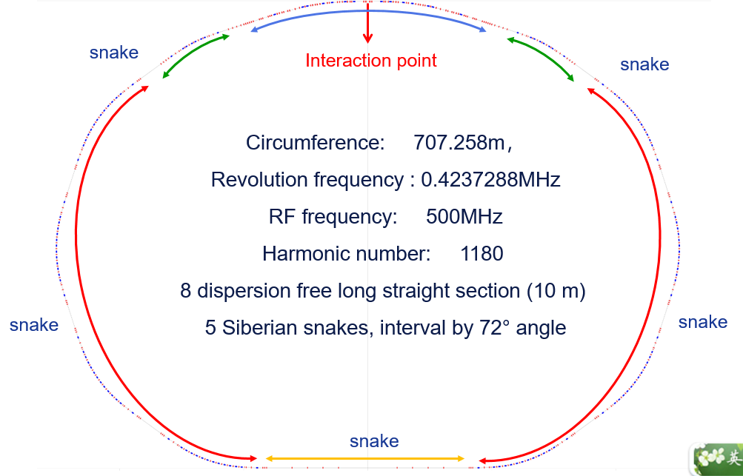
Lattice B: with FODO arc
Geometry of electron ring
Interaction region
2. Long arc section
3. Short arc section
4. Technical section
*Dr. Weiwei Gao

Slide 10
Lattice B: with FODO arc
For long arc
  Composed of 8 achromatic super-periods, each super-period is composed of 6 FODO cells and 2 triplets compensate the dispersion. Two FODO cells compose a –I transformation
For short arec
  Used to connect interaction region and long arc section
  Composed of 3 FODO
  Adjust angle suitable for Siberian Snake
For technical section
  Dispersion free, 71.3805m long
  Tune can be adjusted flexibly
  set up the injection system and Separate beam

Slide 11
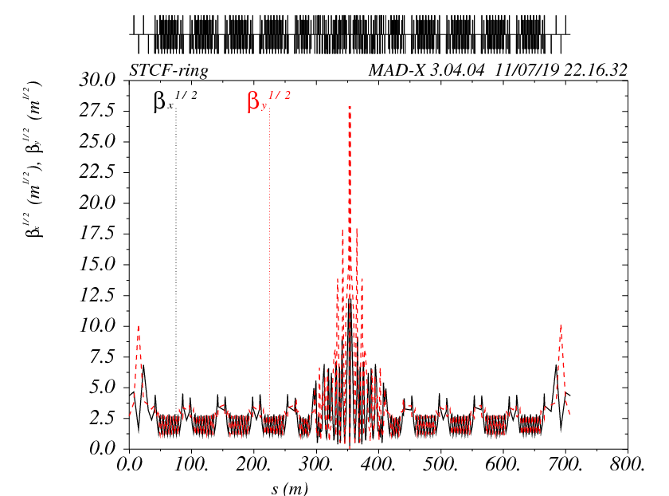
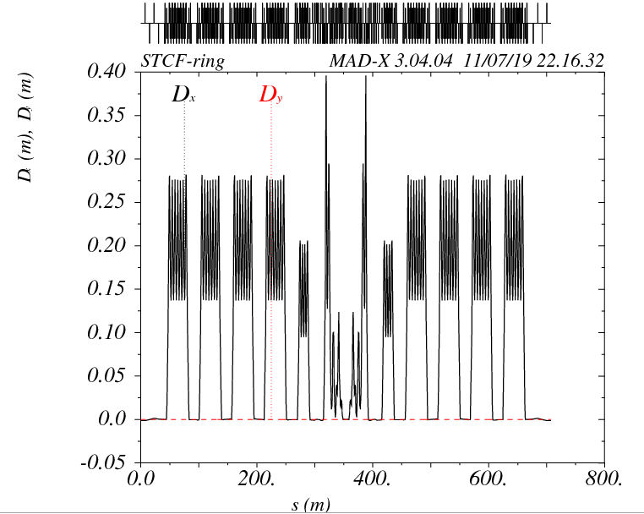
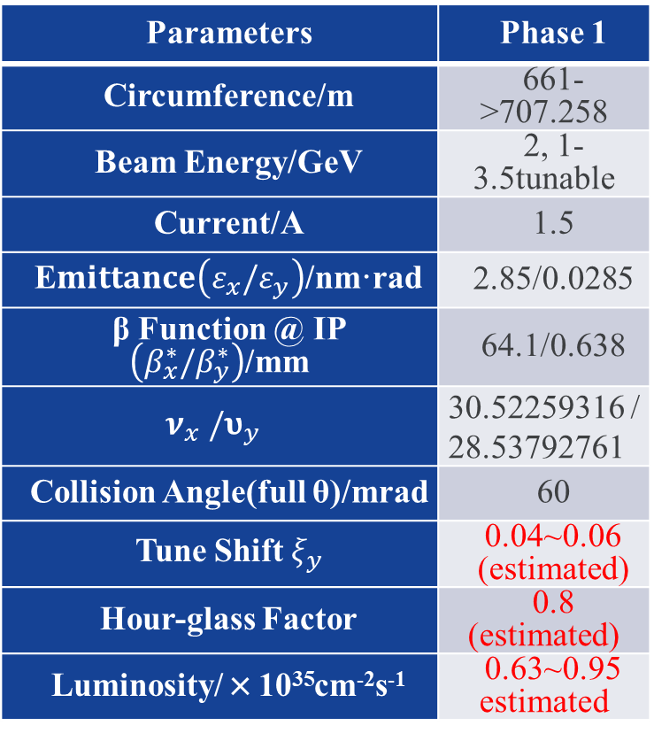
Lattice B: with FODO arc
Lattice function of the whole ring (designing in progress)
Parameters | Phase 1
Circumference/m | 661->707.258
Beam Energy/GeV | 2, 1-3.5tunable
Current/A | 1.5
E$mittance\left(ε_{x}/ε_{y}\right)$/nm·rad | 2.85/0.0285
β Function @ IP $\left({β_{x}^{∗}/β}_{y}^{∗}\right)$/mm | 64.1/0.638
$${ν_{x}^{}/υ}_{y}^{}$$ | 30.52259316 / 28.53792761
Collision Angle(full θ)/mrad | 60
Tune Shift $ξ_{y}$ | 0.04~0.06 (estimated)
Hour-glass Factor | 0.8 (estimated)
Luminosity/×10³⁵cm⁻²s⁻¹ | 0.63~0.95 estimated
Notes:
Parameters
value
Circumference[m]
707.258
Optimized energy[GeV]
2
Horizontal beta at IP[m]
0.06410453805
Vertical beta at IP[m]
0.0006384988995
tunx/tuny
30.52259316 / 28.53792761
Natual chromaticity
-95.29129881/-346.2393275
Horizontal emittance[nmrad]
2.85
Vertical emittance[nmrad]
0.0285
Momentum compaction factor
1.237e-3
Energy spread
4.034e-4
Energy loss per turn[MeV]
0.07837
Horizontal beam size at IP[um]
13.61
Vertical beam size at IP[um]
1.39
Luminosity[cm⁻² S⁻¹]
1.58×10³⁵（beam-beam parameters=0.1）

Slide 12
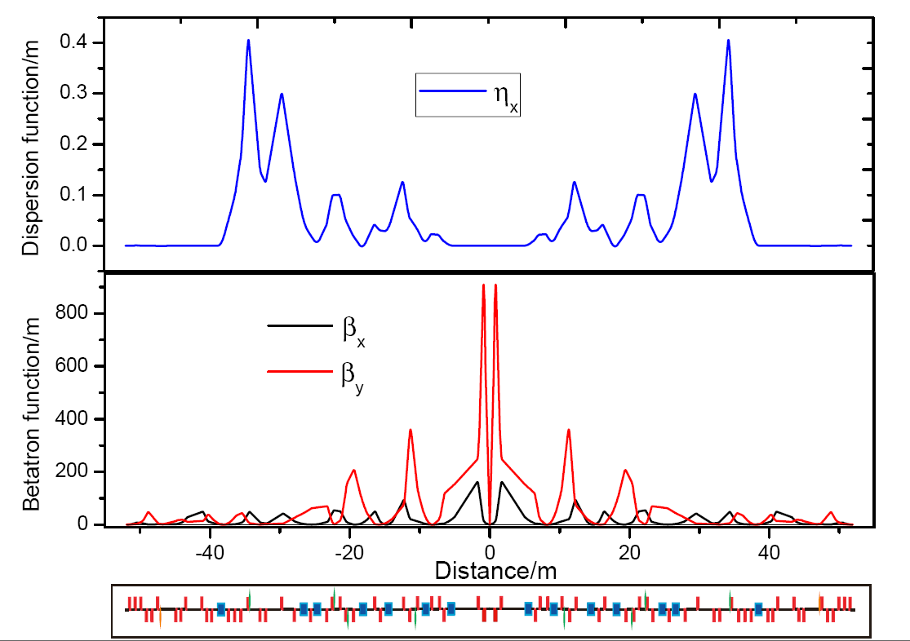
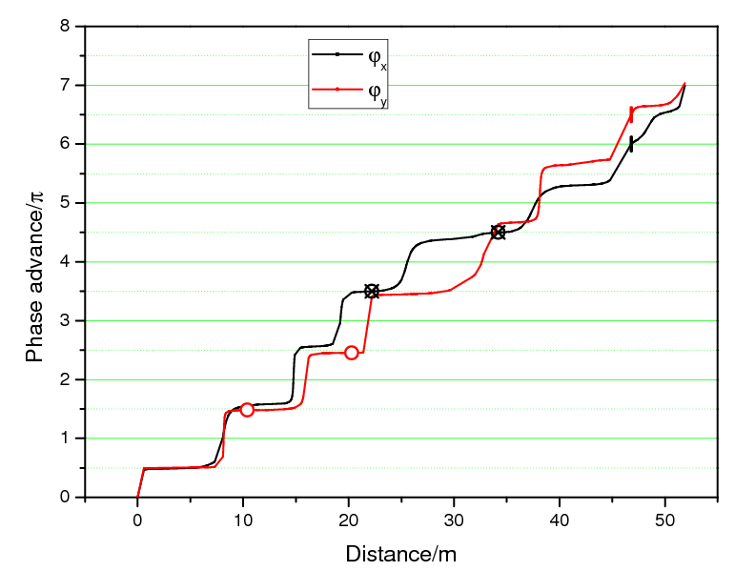
Lattice B: with FODO arc
Lattice function of the interaction region
For the top right picture:
Horizontal phase advance (black line), vertical phase advance (red line);
Vertical chromaticity correction sextupoles (red dots),
Horizontal chromaticity correction Sextupoles (black dots),
crab sextupoles (small vertical line).
phase between IP to the end of the interaction compose telescope(7*π).

Slide 13
Accelerator Physics: Electron Polarization
An odd number of full-strength solenoid snakes will be installed in the storage ring at equal azimuth intervals to let the n-axis (stable spin direction) be longitudinal in the interaction point. More snakes, higher P_{avg}
With symmetry structure design, the dimension of the problem is 4. The design of snake is equivalent to solving 4 nonlinear equations, requires at least 7 quadrupoles. Particle Swarm Optimization (PSO) algorithm is used to design the snake

Slide 14
Electron Beam Polarization
±I scheme
±L scheme
element | strength | Solenoid is on | Solenoid is off
Sol | Ks (m⁻¹) | 1.04668 | 0
Q1 | K1 (m⁻²) | 1.965228 | 2.293008
Q2 | K1 (m⁻²) | -1.857034 | -2.701243
Q3 | K1 (m⁻²) | 2.508496 | 2.915654
Q4 | K1 (m⁻²) | -2.206878 | -0.265742
Transformation |  | 1.000000 0.000000 0.000000 0.000000 0.000000 1.000000 0.000000 0.000000 0.000000 0.000000 -1.000000 0.000000 0.000000 0.000000 0.000000 -1.000000 | 1.000000 0.000000 0.000000 0.000000 0.000000 1.000000 0.000000 0.000000 0.000000 0.000000 -1.000000 0.000000 0.000000 0.000000 0.000000 -1.000000
Snake length (m) |  | 9.60
element | strength | Snake is on | Snake is off
Sol | Ks (m⁻¹) | 1.04668 | 0
Q1 | K1 (m⁻²) | 0.931246 | 0
Q2 | K1 (m⁻²) | -0.612851 | 0
Q3 | K1 (m⁻²) | 2.952786 | 0
Q4 | K1 (m⁻²) | -2.852517 | 0
Transformation |  | 1.000000 9.750000 0.000000 0.000000 0.000000 1.000000 0.000000 0.000000 0.000000 0.000000 -1.000000 -9.750000 0.000000 0.000000 0.000000 -1.000000 | 1.000000 9.750000 0.000000 0.000000 0.000000 1.000000 0.000000 0.000000 0.000000 0.000000 1.000000 9.750000 0.000000 0.000000 0.000000 1.000000
Snake length (m) |  | 9.75

Slide 15
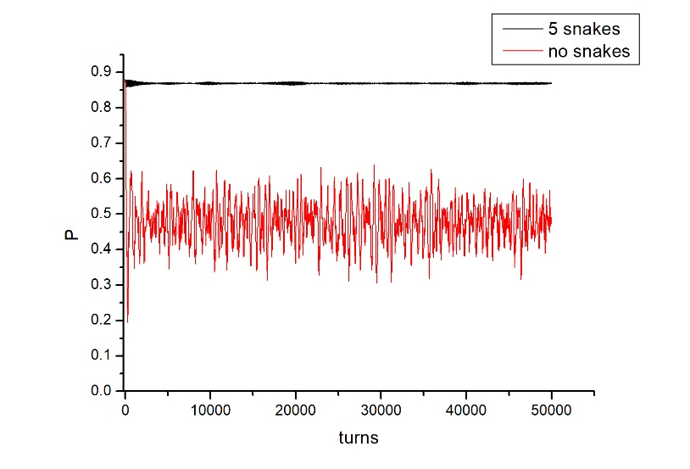
Electron Beam Polarization
Result of ±L scheme
Question to communicate:
  ±I or ±L form? Which is better for snakes?
  Several machines used ±L scheme.
  ±I scheme may be better in beam dynamics because of the spin transparent issue.
E=2.20365GeV, Vs=5, imperfect spin resonance.①no snake, and ②five snakes, spin tracking of 50 particles with Gaussian distribution for 50000 turns. Initial polarization is 0.88.
*Dr Jieqin Lan

Slide 16
Accelerator Technologies: Feedback
Impedance and Collective Effects
  Characteristics for Super Tau-Charm Factory beam
    High Current：~2A; (compared to light sources)
    Low Energy (compared to B factory, FCC-ee/CEPC…)
    Single Bunch: TMCI, IBS, etc.；Multi-bunch: Coupled-Bunch Instability, HOM, etc.
Beam Feedback system should handle:
  both horizontal and vertical planes
    Longitudinal(potential)
  various unstable modes coming from unknown sources:
    Resistive wall
    Photo electron instability
    Fast ion instability
    Injection kicker induced oscillation
*Prof. Zeran Zhou, details presented in his presentation

Slide 17
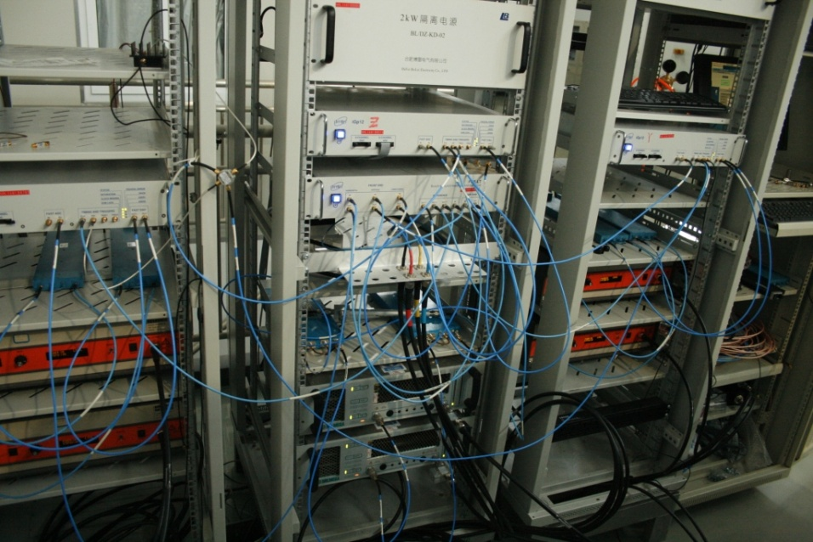
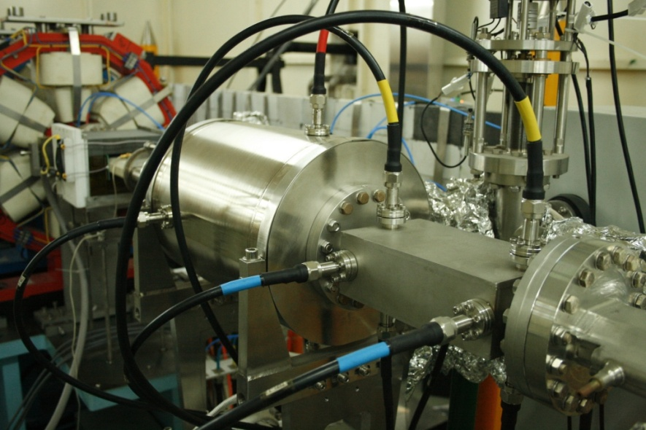
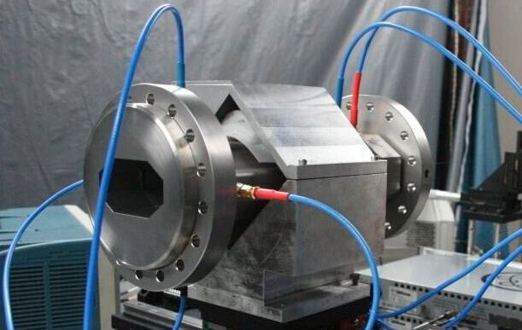
Beam feedback for STCF
    This feedback system was set up with digital transverse and longitudinal feedback system in the year 2014, used in HLSII upgrade project.

Slide 18
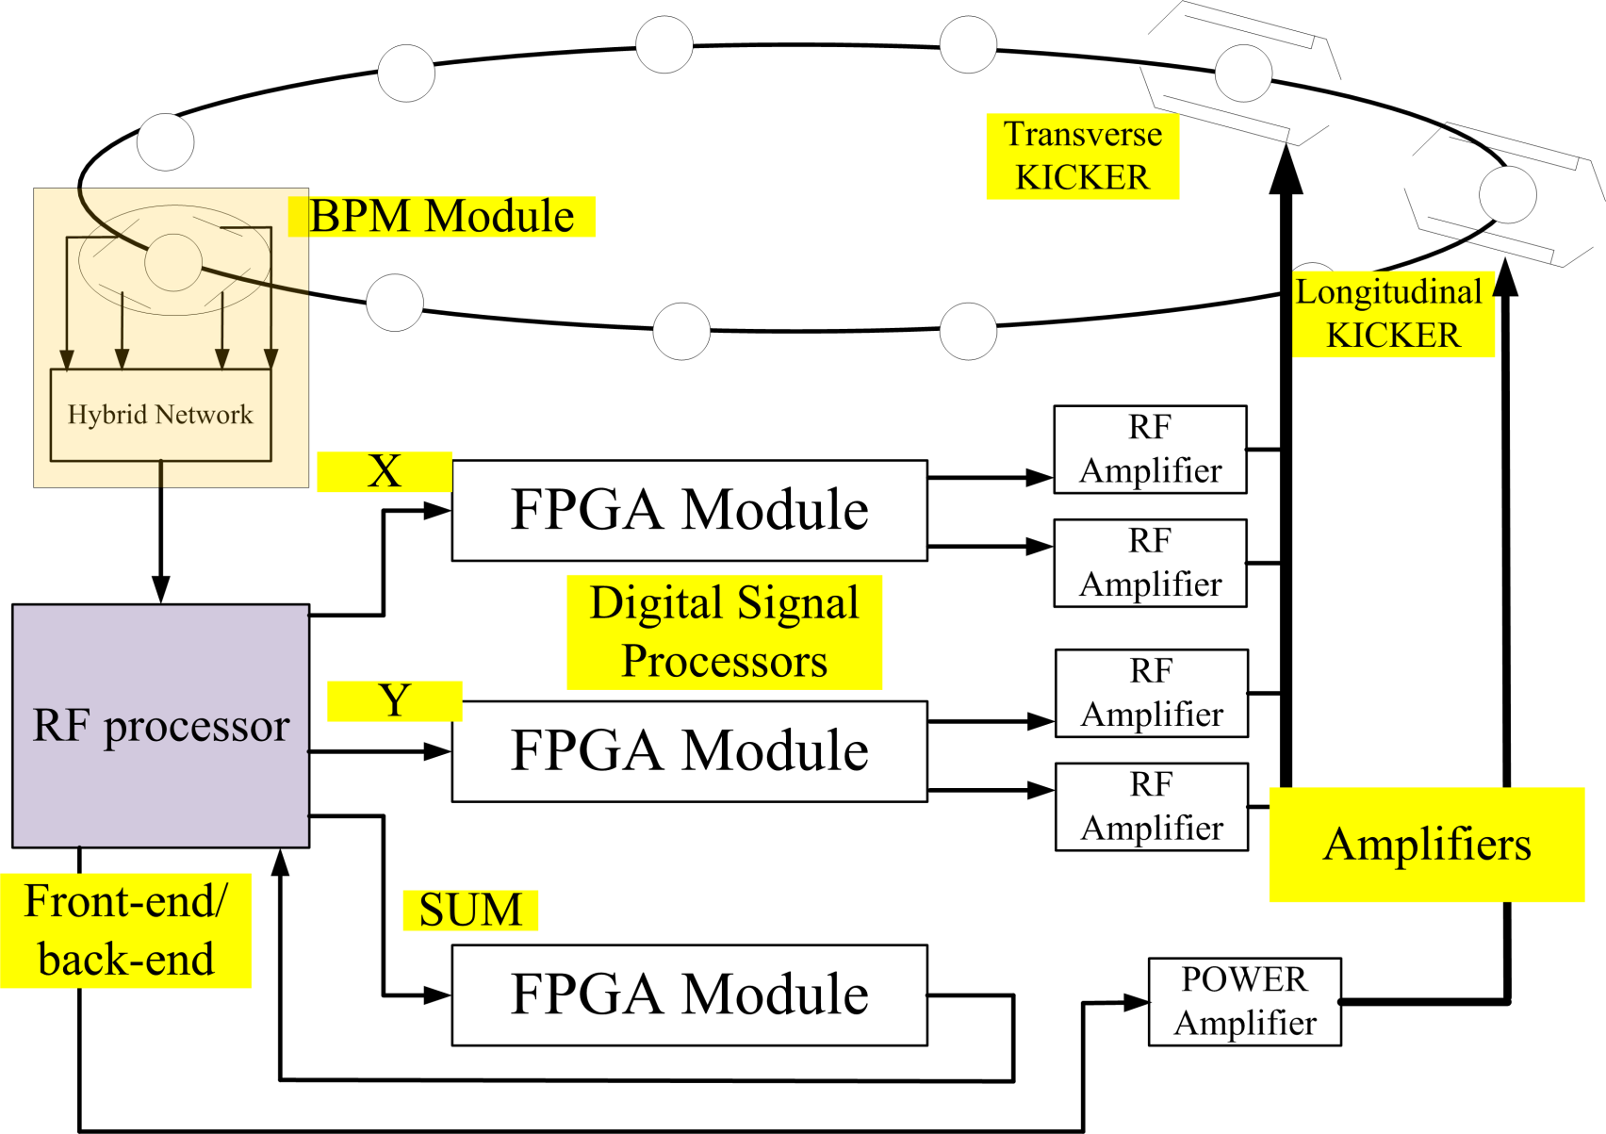
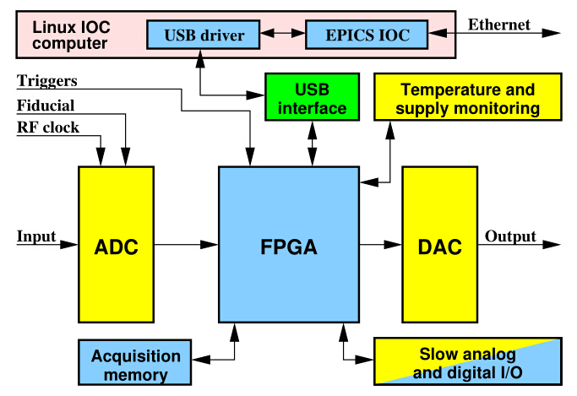
Beam feedback for STCF
New Processor is under developing
  Designing for 500MHz RF frequency of storage ring

Slide 19
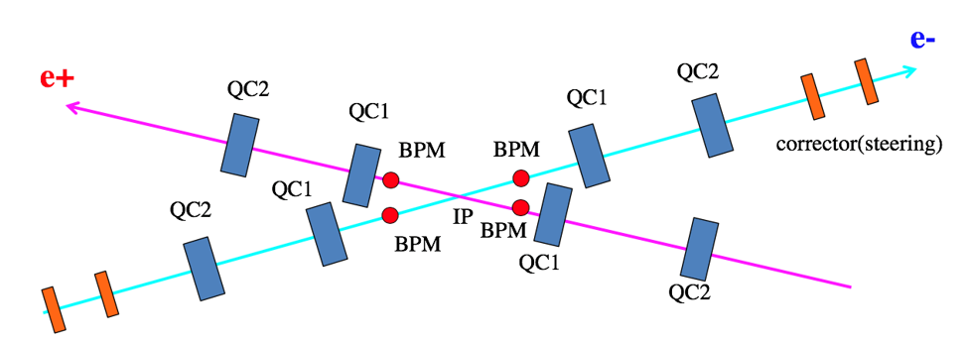
IP feedback for STCF
Maintaining the beams of a two-ring collider in head-on collision requires an active feedback that moves one beam relative to the other to seek maximum luminosity.
To maximize luminosity, a feedback system adjusts the relative transverse (x, y) position and vertical angle (y') at the IP to find the horizontal offset that maximizes luminosity.
  (y' is sensitive due to the small aspect ratio (y/x) of the beams at the IP)
*Prof. Zeran Zhou, details presented in his presentation

Slide 20
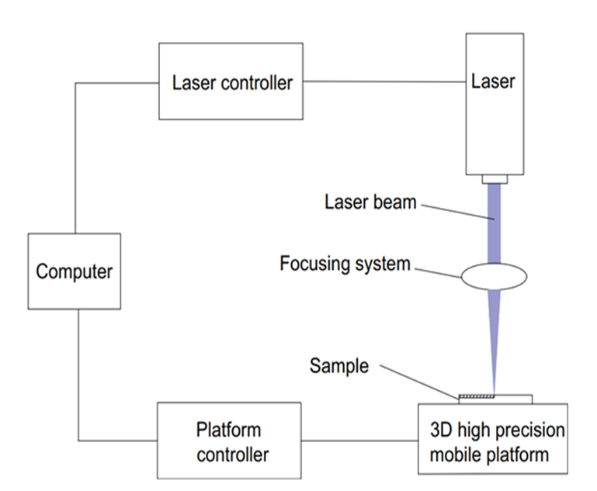
Vacuum system*
Laser treatment to suppress the E-cloud
Methods to suppress the secondary electron emission:
Using the low secondary electron yield(SEY) materials.
Coating low SEY film on the chamber wall(NEG, a-C,).
Machining groove.
Laser treatment on the surface of vacuum chamber.
Advantage:
low cost,
easy to carry out,
good stability.
Under the atmosphere
Schematic diagram of laser treatment system
*Prof. Yong Wang, Dr Bo Zhang, Miss Ge, Mr Wang, etc. detail presented in their presentation
Notes:
Laser treatment to suppress SEY as a new method was suggested in 2014 by Raze in daresbury laboratory.

Slide 21
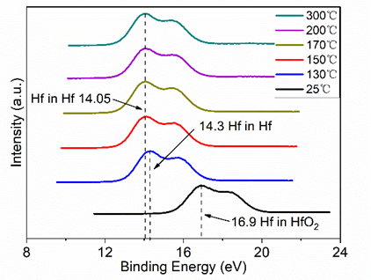
Vacuum system
Low activation temperature TiZrHfV films
The oxides of Ti and V have been reduced to the metal state at 150 °C while the reduced temperature of Zr and Hf oxides are 130 °C.
The TiZrHfV film has completed the transformation of oxides to sub-oxides and metals at relatively low temperatures.
Lower activation temperature of TiZrHfV NEG film compared to traditional TiZrV NEG film.
Hf 4f XPS spectra of TiZrHfV film at various heating temperatures
Notes:
Non-Evaporative Getter NEG
Generally, the activation temperature is mainly influenced by the binding energy between NEG and active molecules. Hence, the activation temperature of NEG film can be directly detected by mearing the binding energy of each component metal. We are the first to use XPS to detect the activation temperature of the optimized film under different temperature range.
Figure show the excited information of Titanium、Zirconium、Vanadium spectrum under different temperatures. Taking Ti as an example, the binding energy of Ti 2p is 458.7 eV at room temperature, indicating that the Ti element mainly exists as Ti dioxide on the surface of the sample due to the surface oxidation. a large amount of oxidized state Ti^{n+} has been reduced at 130 ℃, and the oxidation state of Ti on the surface has substantially disappeared at 150 ℃, which is basically consistent with the activation effect of film at 300 ℃. Hence, the film can remove the oxidized Ti at a very low temperature.
As the main components of the film, the sorption performance of Hafnium is important for this new type NEG film. As shown in the Figure, the Hf mainly exists as Hf dioxide in the NEG film under room temperature, indicating that the surface oxidation of Hf. The peak position of Hf 4f has shifted to the binding energy of the metallic state of Hf when heated to 130 °C and higher temperature. In addition, it’s obvious that the Hf is mostly changed from Tetravalent Hf to Zero-valent Hf under 150 ℃ or higher temperature, indicating that the Hf can be fully activated under 150 ℃.
We know that TiZrV films need to be heated at 180 ° C for 24 hours to be activated, so it is the addition of Hf element that make the activation temperature greatly reduced.

Slide 22
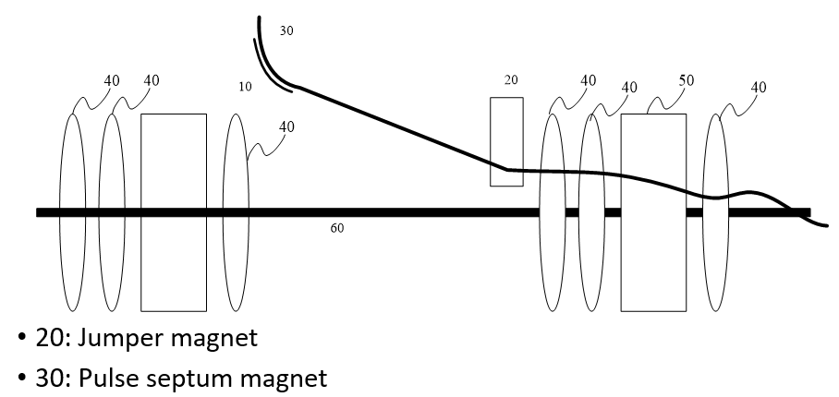
New Technologies
Prof. Xiangqi Wang and his graduate students have proposed a novel injection system and several kinds of novel magnets.
  Shown in Mr Tao Liu’s presentation.
    Proposed a novel design concept of injection system without disturbance to the stored beam, and the emittance of the injected beam can be reduced by ‘jumper magnets’.

Slide 23
Conclusion: Status
Last Year
  A research team for STCF accelerator has been.
  Key issues and technologies have been listed.
  Physics and technical works are underway.
  Short of hands: faculties, postdocs and experienced engineers.
This Year
  Accelerator parameters and basic linear lattice is given.
  Polarization, beam-beam and other accelerator physics work is underway.
  Several key technologies have been developed.
  All works above are finished by a very small team (6 people, part-time).

Slide 24
Future Plan
Accelerator Physics
  Linear and nonlinear optimization, complete a reasonable lattice
    By beam dynamic study; also, using intelligent optimization algorithm
  Collaboration with colleagues
    For lattice design and beam-beam
Accelerator Technologies
  Set up bench tests for instrumentations and vacuum
  Develop superconducting technologies

Slide 25
Thank you for your attention

