Slide 1
Machine-Detector Interface
S. Sinyatkin
Budker Institute of Nuclear Physics
26 September 2019
Joint Workshop on Future charm-tau Factory

Slide 2
Boundary conditions I
To obtain high luminosity of the SCTF collider, small transverse beam size at the IP is required.
Detector creates 1.5 T solenoidal field of ±0.6 m length with minimum material (accelerator components) in this area.
On the reference orbit solenoid field produces betatron coupling, dispersion and finally blows up the vertical emittance.
To suppress the betatron coupling produced by main detector solenoid field, a compensating solenoid is required.

Slide 3
Boundary conditions II
For better beam dynamics the distance between the IP and the first defocusing lens (L*) should be as short as possible.
The full crossing angle of 60 mrad is required for the Crab-Waist scheme. The horizontal field and the betatron coupling appear when the solenoids axis do not coincide with the beam trajectory.
A cross-talk between the detector field and the FF quadrupoles should be avoided (otherwise it produces unwanted field components). The longitudinal field decay area for large aperture solenoids is large and complicates the betatron coupling compensation scheme.

Slide 4
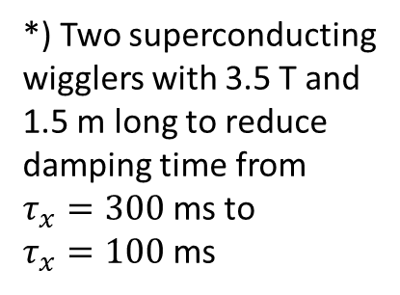
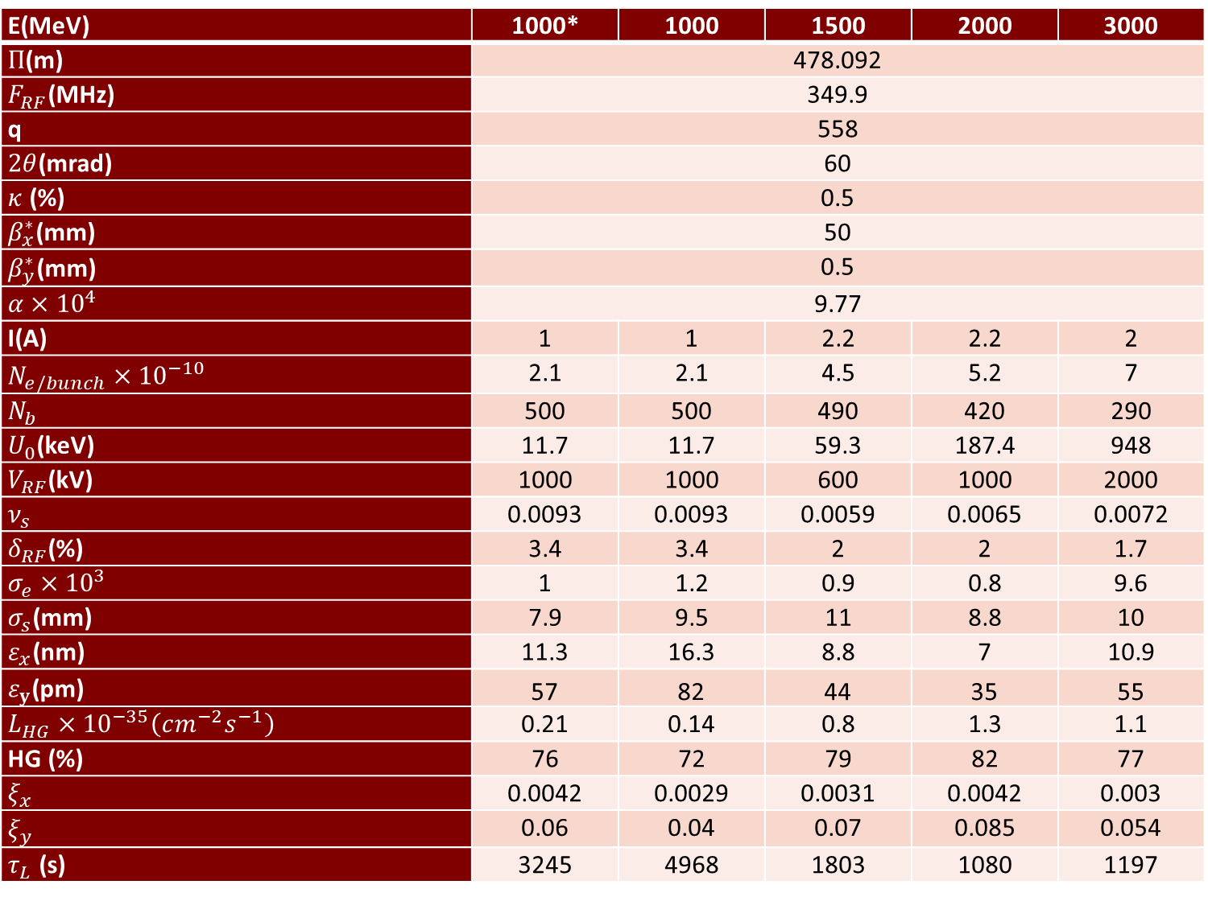
SCTF
Parameters
E(MeV) | 1000* | 1000 | 1500 | 2000 | 3000
$Π$(m) | 478.092
$F_{RF}$(MHz) | 349.9
q | 558
$2θ$(mrad) | 60
$κ$ (%) | 0.5
$β_{x}^{∗}$(mm) | 50
$β_{y}^{∗}$(mm) | 0.5
$α×{10}^{4}$ | 9.77
I(A) | 1 | 1 | 2.2 | 2.2 | 2
$N_{e/bunch}×{10}^{−10}$ | 2.1 | 2.1 | 4.5 | 5.2 | 7
$N_{b}$ | 500 | 500 | 490 | 420 | 290
$U_{0}$(keV) | 11.7 | 11.7 | 59.3 | 187.4 | 948
$V_{RF}$(kV) | 1000 | 1000 | 600 | 1000 | 2000
$ν_{s}$ | 0.0093 | 0.0093 | 0.0059 | 0.0065 | 0.0072
$δ_{RF}$(%) | 3.4 | 3.4 | 2 | 2 | 1.7
$σ_{e}×{10}^{3}$ | 1 | 1.2 | 0.9 | 0.8 | 9.6
$σ_{s}$(mm) | 7.9 | 9.5 | 11 | 8.8 | 10
$ε_{x}$(nm) | 11.3 | 16.3 | 8.8 | 7 | 10.9
$ε_{y}$(pm) | 57 | 82 | 44 | 35 | 55
$L_{HG}×{10}^{−35}\left(cm^{−2}s^{−1}\right)$ | 0.21 | 0.14 | 0.8 | 1.3 | 1.1
HG (%) | 76 | 72 | 79 | 82 | 77
$ξ_{x}$ | 0.0042 | 0.0029 | 0.0031 | 0.0042 | 0.003
$ξ_{y}$ | 0.06 | 0.04 | 0.07 | 0.085 | 0.054
$τ_{L}$ (s) | 3245 | 4968 | 1803 | 1080 | 1197
*) Two superconducting
wigglers with 3.5 T and
1.5 m long to reduce
damping time from
$τ_{x}=300$ ms to
$τ_{x}=100$ ms
A. Bogomyagkov

Slide 5
Interaction Region (IR)
On beam trajectory detector creates 1.5 T solenoidal field of ±0.6 m length, needs to be compensated.
Vertical emittance budget is ≤30 pm for the solenoid fields.
Full crossing angle is 60 mrad.
Accelerator equipment should be inside the 0.175 rad cone.
A space between Y-chamber and the cryostat is needed to accommodate BPM, flange, bellows, HOM absorber(?), luminometer (?!), etc.
Collimation system (?!)
First (defocusing) quad QD0 is at L*= 0.9 m from the IP.

Slide 6
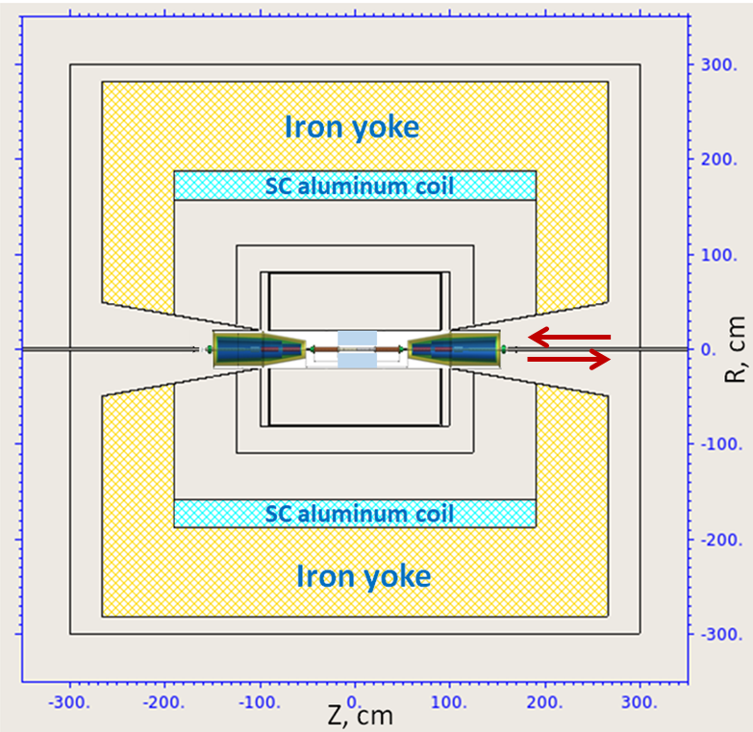
Detector geometry
IR area: BPMs, flanges, bellows, compensating solenoids, screening solenoids, FF quadrupole lenses, steering magnets.
Additional screening area.

Slide 7
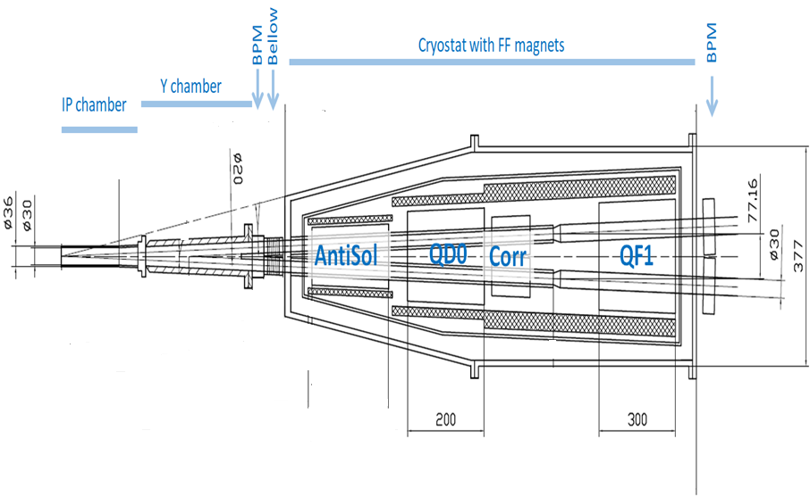
Baseline IR layout
0.175 rad
Be- chamber
0.54 m
QD0
QF1
Y- chamber
Compensating
Solenoid
0.15 m
Screening
Solenoid
IP
0.65 m
FF Quads
0.85 m
0.9 m
0.74 m

Slide 8
Machine-detector interface
Compensating
Solenoid
Screening
Solenoid
Y- chamber
Be- chamber
BPM
FF Quads

Slide 9
Vacuum chamber, Super KEKB example
Vacuum pipe cooling lines
Vacuum pipe flange
Be- chamber
Y- chamber
Flanges
Bellows

Slide 10
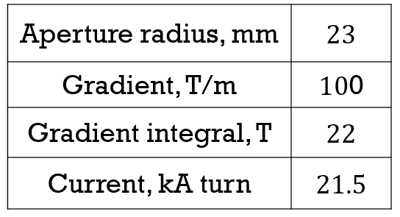
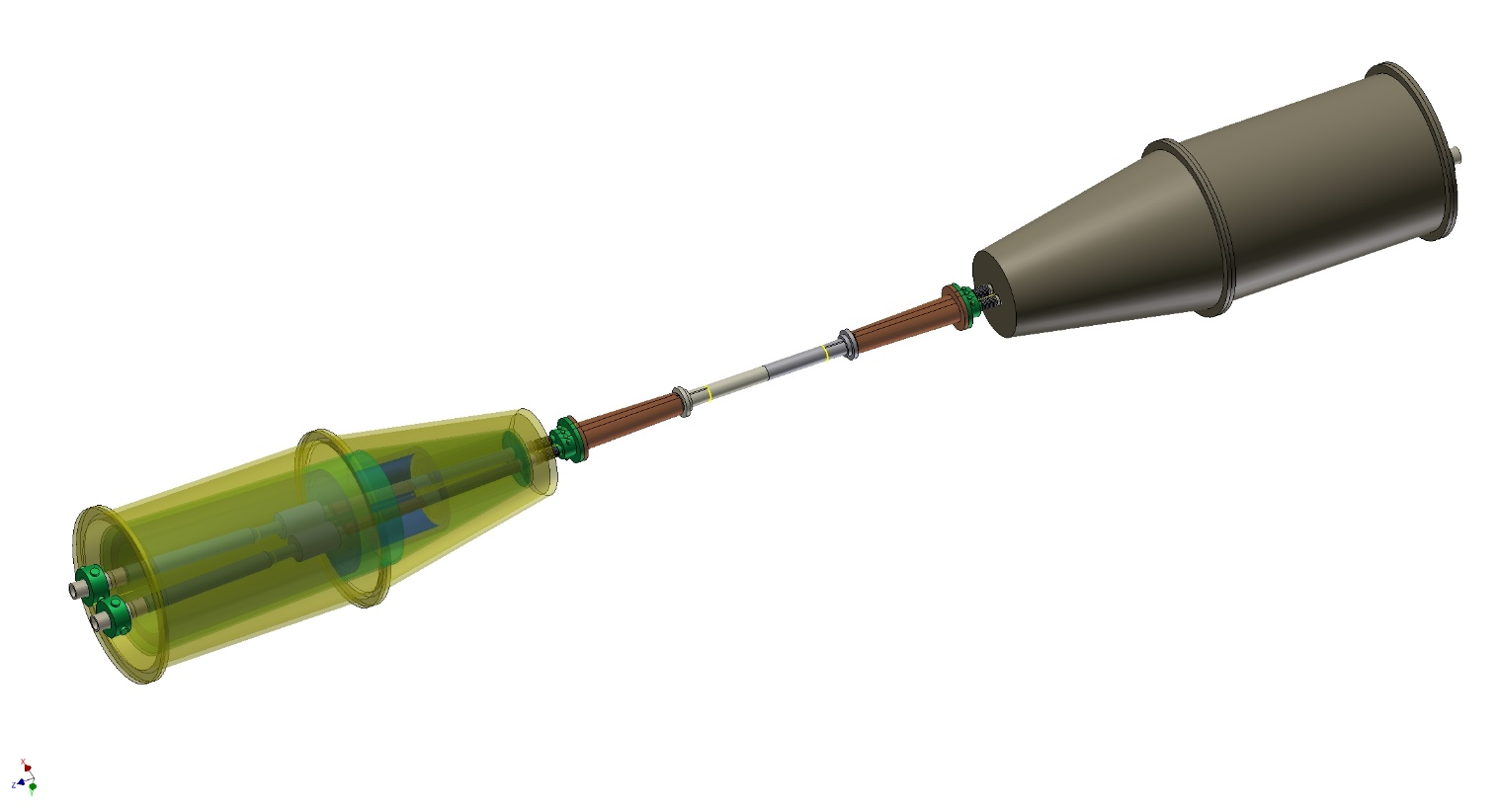
FF lenses
One of the most essential element of the Super CT FF is a dual aperture superconducting quadrupole to squeeze the beams at the IP with the following parameters:
IP
QD0
QF1
3.3 m
IP
IP
Cryostat with FF magnets
Beam trajectories in FF
Cryostat with FF magnets
Artist view of the FF arrangement

Slide 11
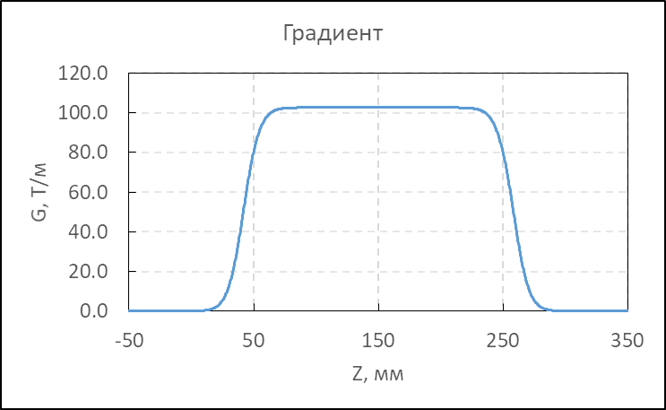
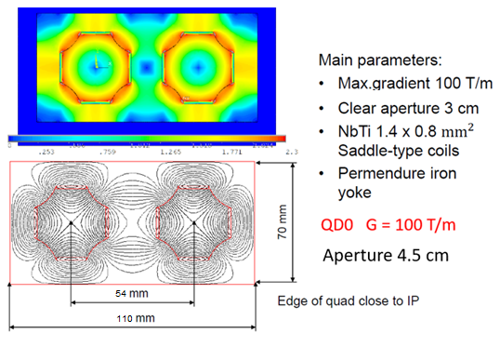
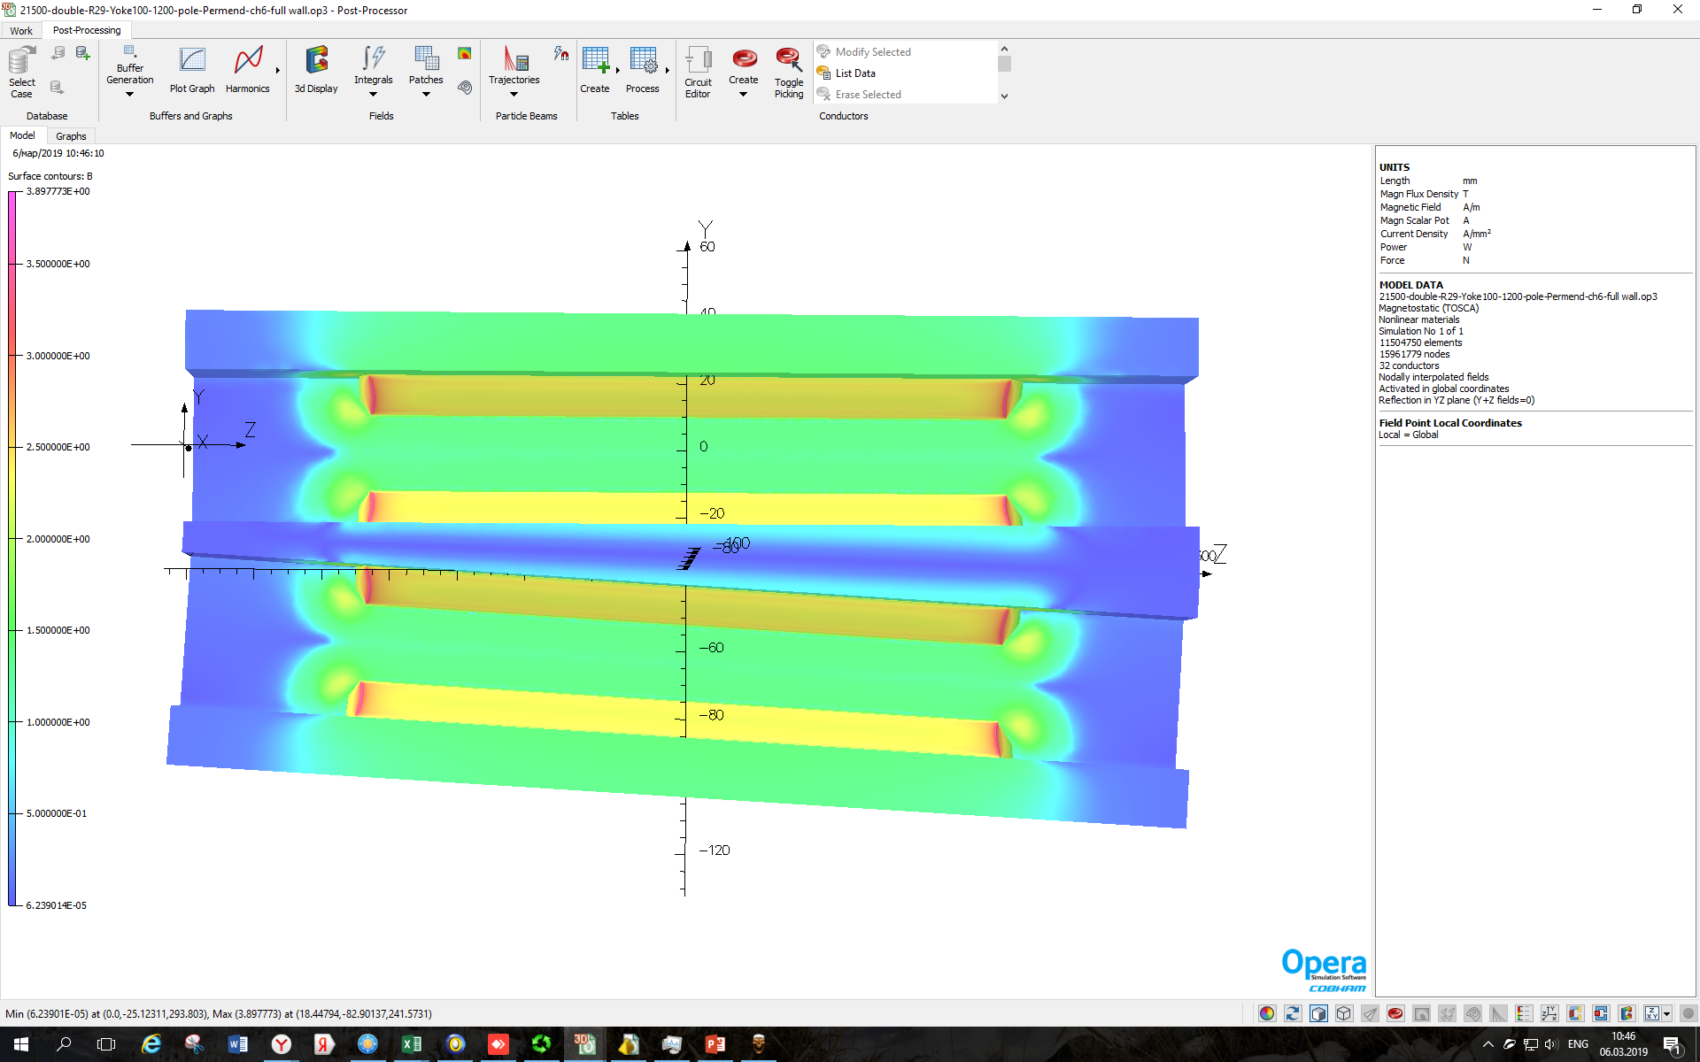
FF lenses
Main requirements:
Compactness.
No transverse interference between elements.
High quality magnetic field in the aperture.

Slide 12
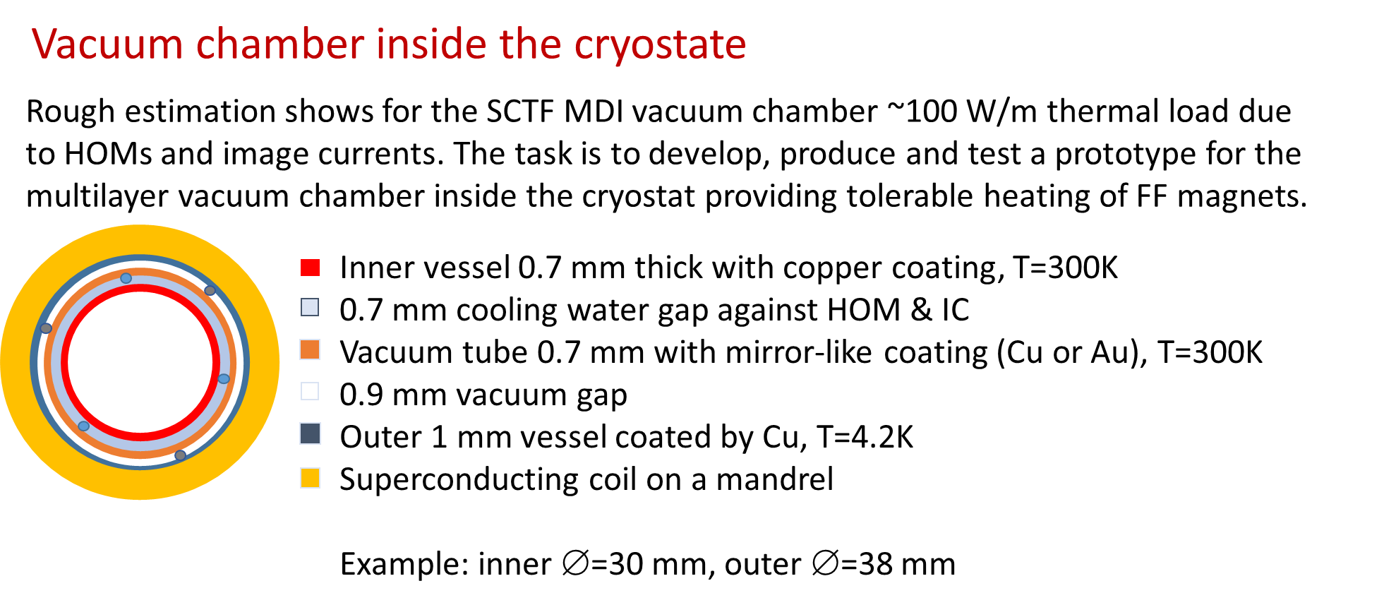
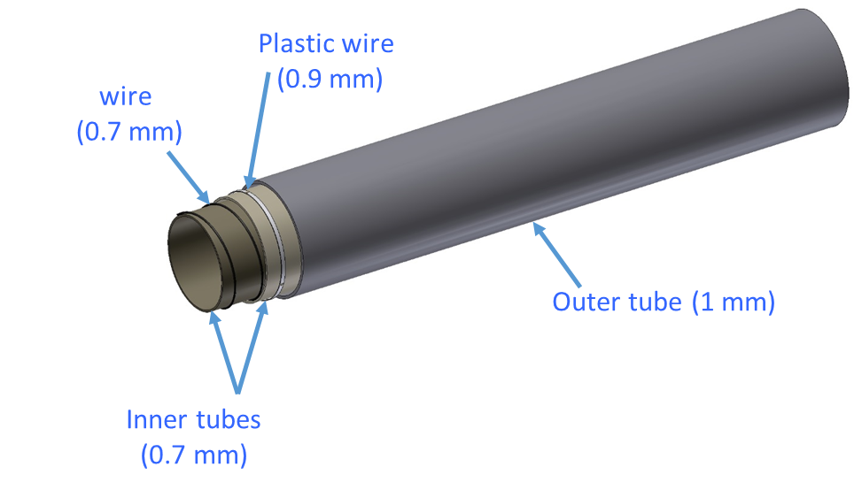
Vacuum chamber: warm to cold (A. Krasnov)
https://indico.cern.ch/event/803859/contributions/3344818/attachments/1807687/2950964/BINP_MDI_Mar_2019.pptx

Slide 13
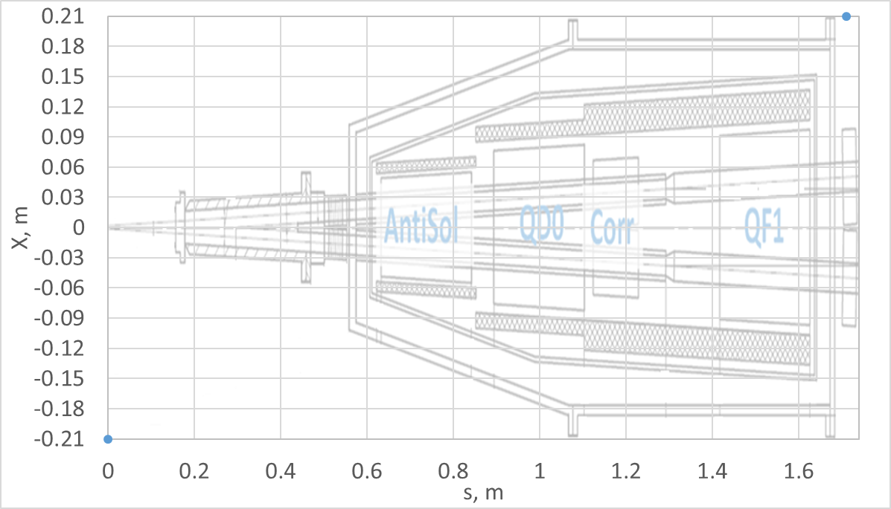
Compensating scheme of solenoid fields
Cylindrical Compensating Solenoid
QD0
QF1
Bs_main
Screening
Solenoid
Bs_comp
FF Quads

Slide 14
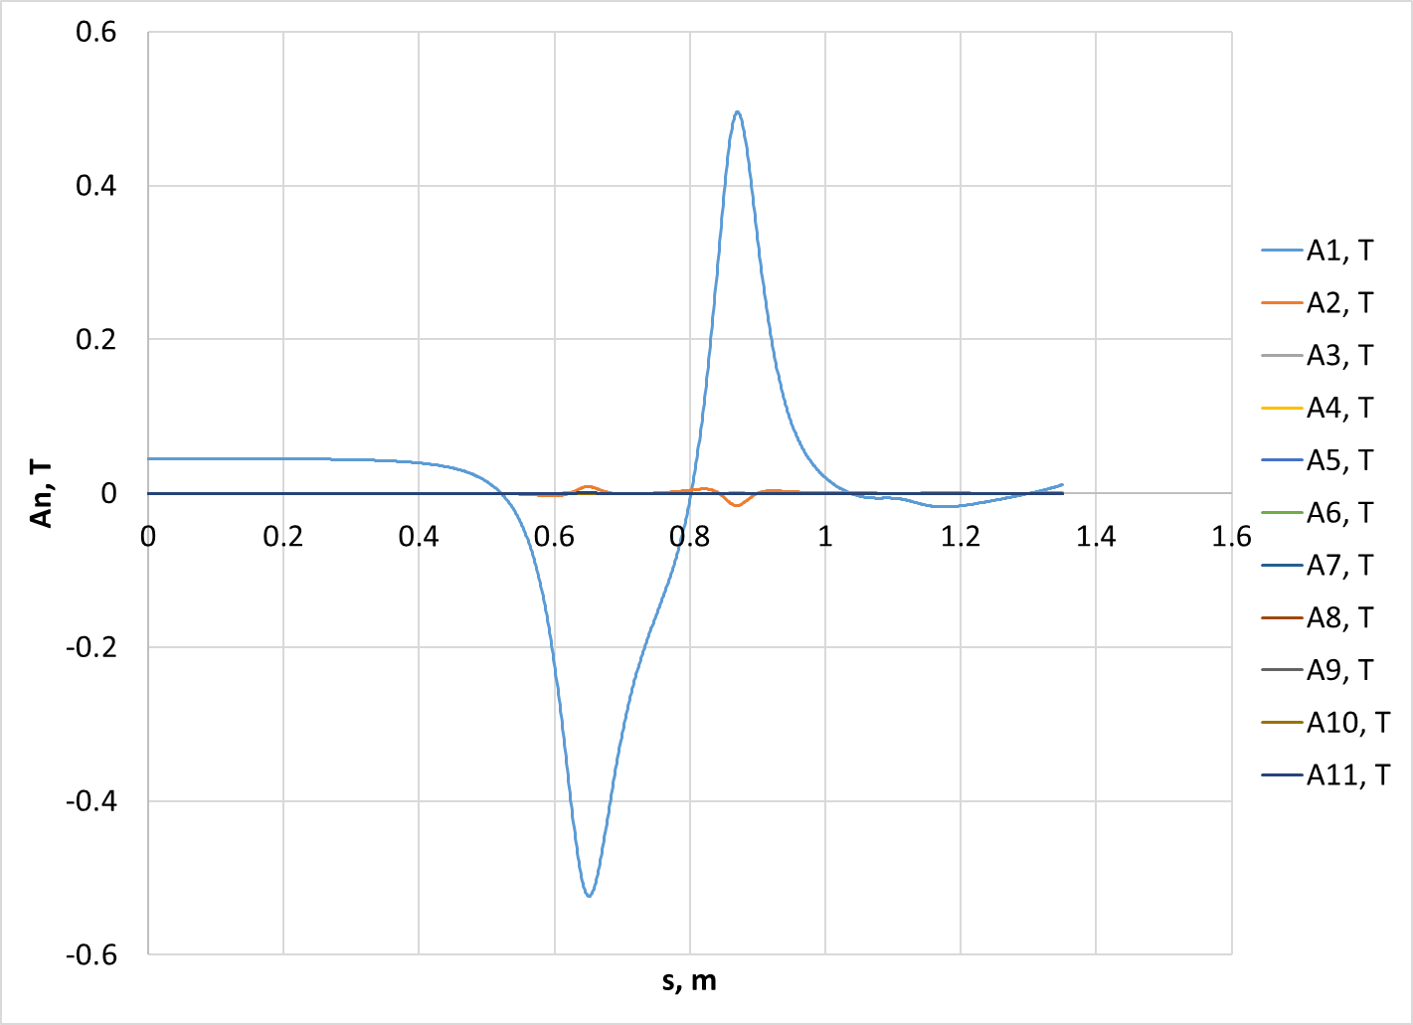
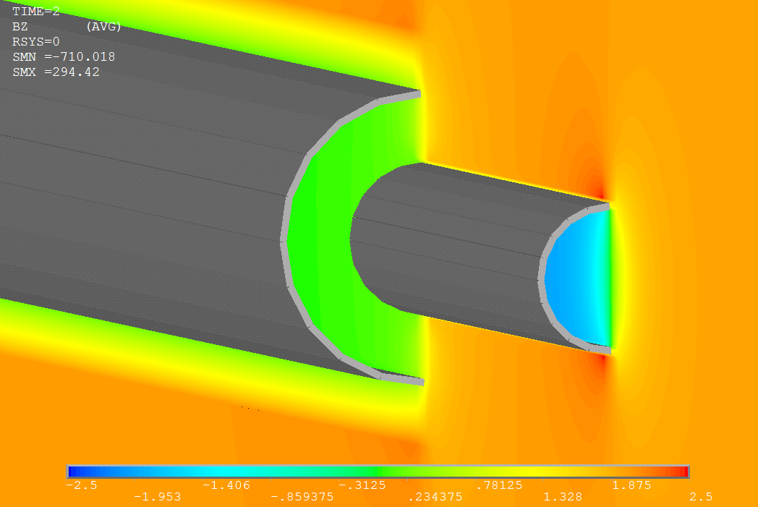
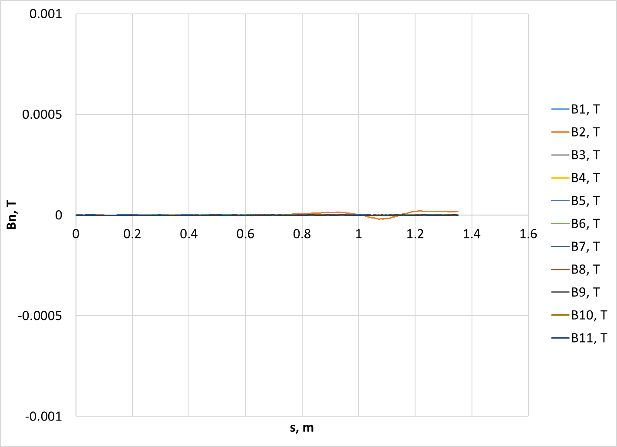
Cylindrical solenoids
Y
S
X
IP

Slide 15
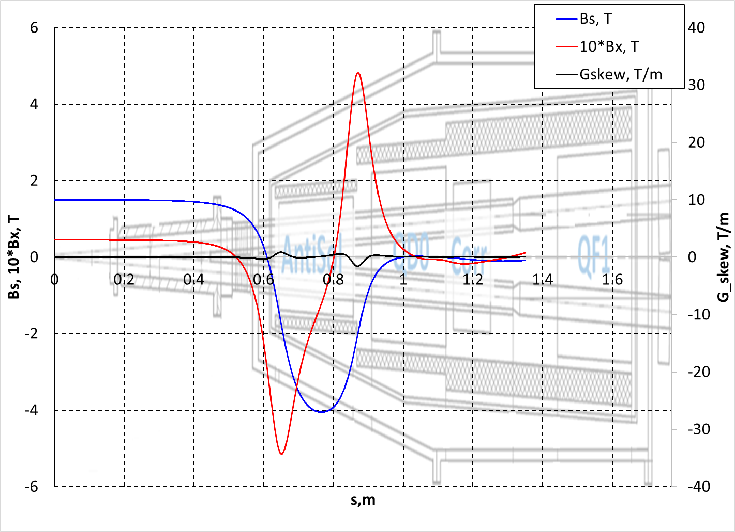
Distribution of magnetic field components
along reference trajectory
Cylindrical solenoid for a both beams
Magnetic field at QD0 entrance (0.9 m):
Bx = 0.3 T
Bs = 0.9 T
G_skew= 0 T/m
R_{harmonic} = 10 mm
An < 10⁻⁴ , n≠1
Bn < 10⁻⁴
Cylindrical Compensating Solenoid
Screening
Solenoid
FF Quads

Slide 16
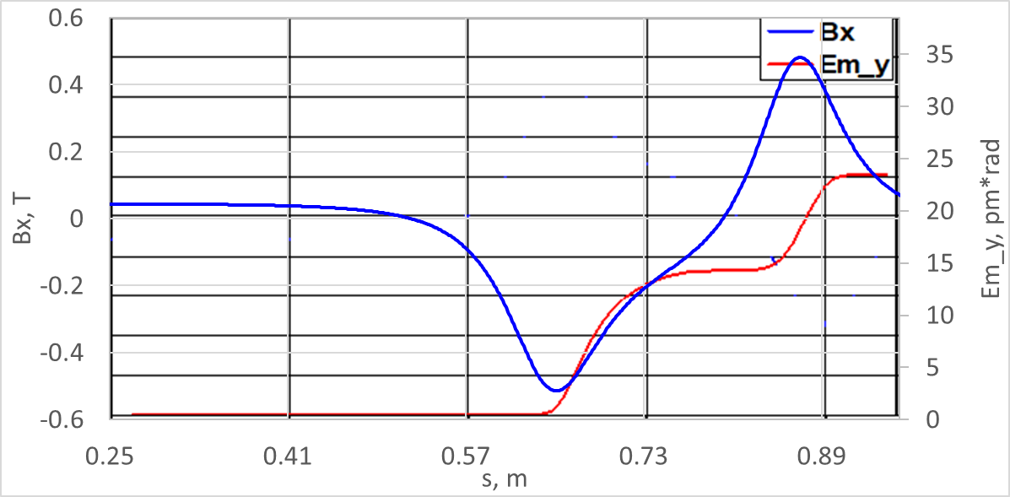
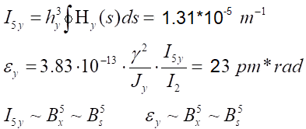
Vertical emittance calculation for baseline
I₂ = 0.832 m⁻¹ β_{y}* = 0.5 mm

Slide 17
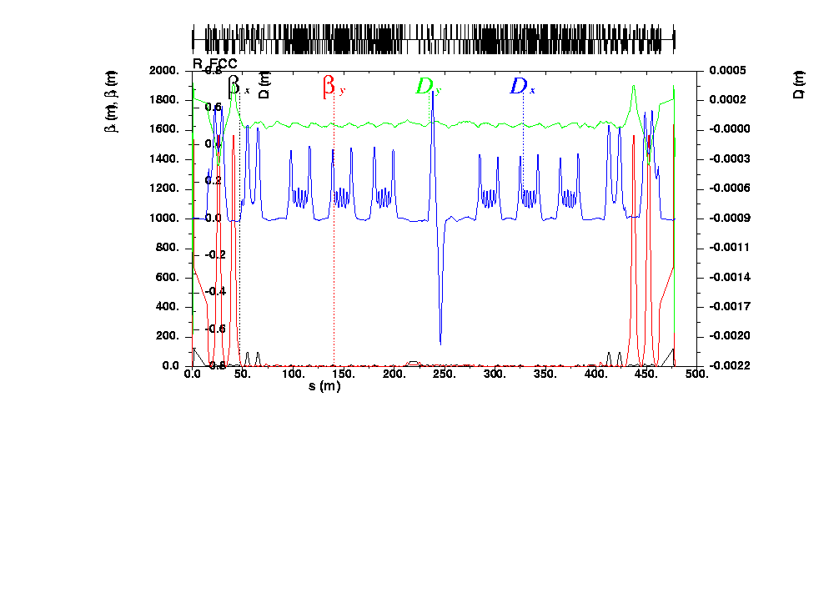
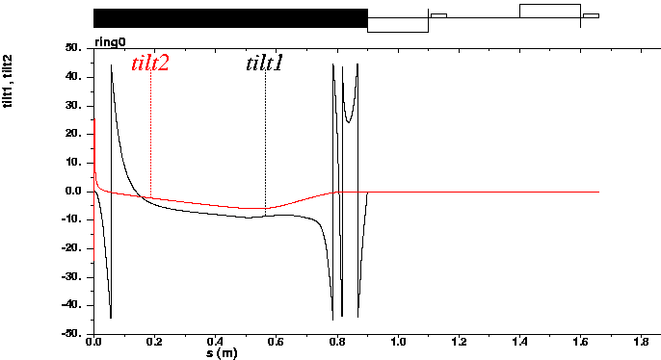
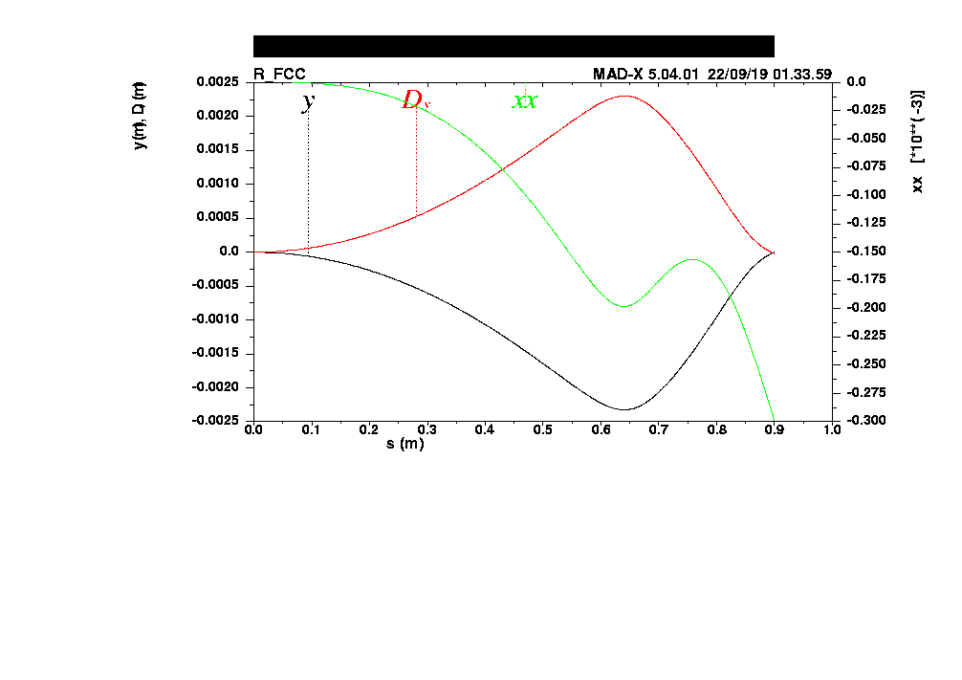
Distribution of magnetic field components
along reference trajectory
Cylindrical solenoid for a both beams
Energy, GeV | 1
Qx | 27.55
Qy | 22.57
Ex, nm*rad | 1.20
Ey, nm*rad | 0.023
Ey / Ex | 0.019
Betx_IP, m | 0.050
alfx_IP | -0.00
Bety_IP, mm | 0.50
alfy_IP | 0.00
dx_IP, m | 4.7E-06
dy_IP, m | 0.000
IP
IP

Slide 18
How to decrease vertical emittance & fringe fields
Decreasing the length of the main solenoid
Increasing the length of compensating
solenoid
Increasing β_{y_IP}
Redistributing current in compensating solenoid
Reducing the main solenoid field:
Introducing elliptical shape of compensating solenoids and additional correctors
ε_{y}~I_{5,y} ~ B_{x}⁵ ~ B_{s}⁵

Slide 19
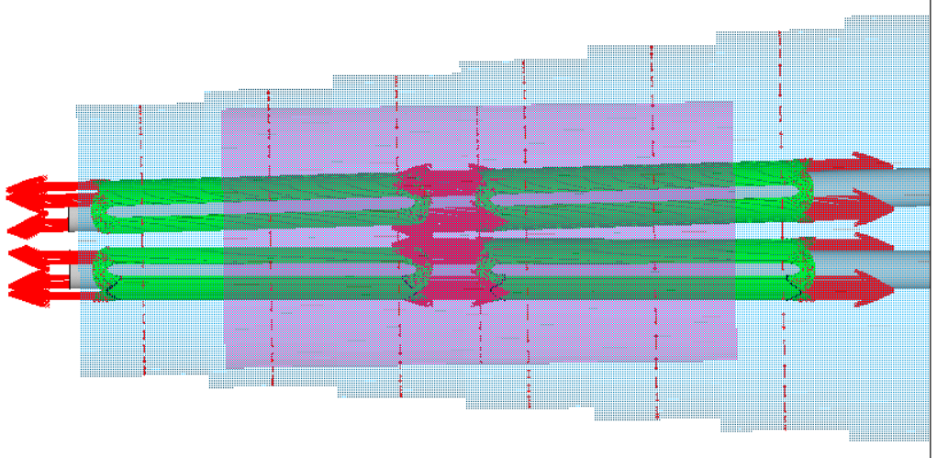
Compensating solenoid
-Elliptical for a both beams
Screening solenoids
Compensating solenoids
Dipole &
Skew quad corrections

Slide 20
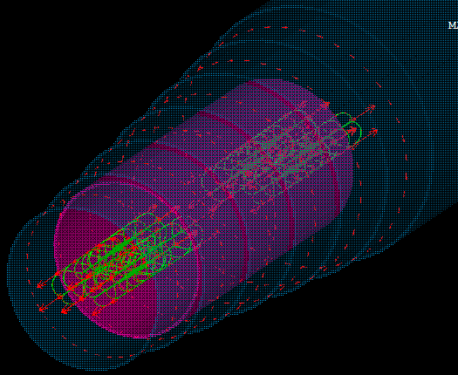
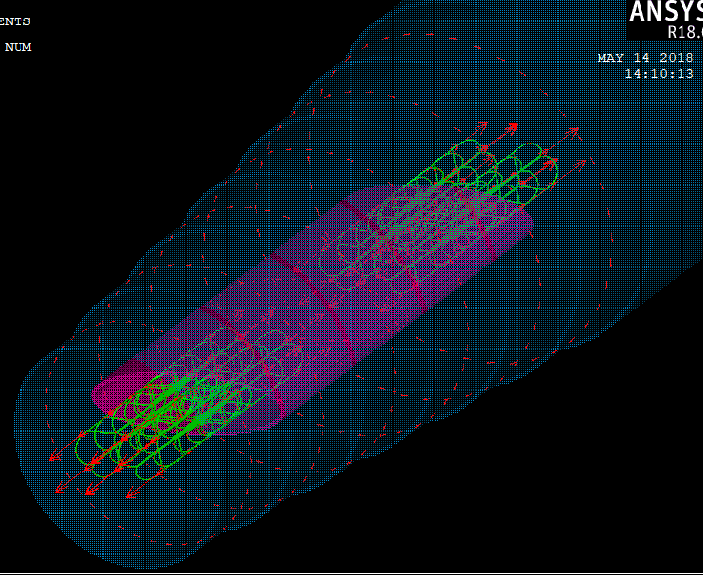
Compensating solenoid
-Cylindrical for a both beams
-Elliptical for a both beams
Screening solenoids
Compensating solenoids
Dipole &
Skew quad corrections

Slide 21
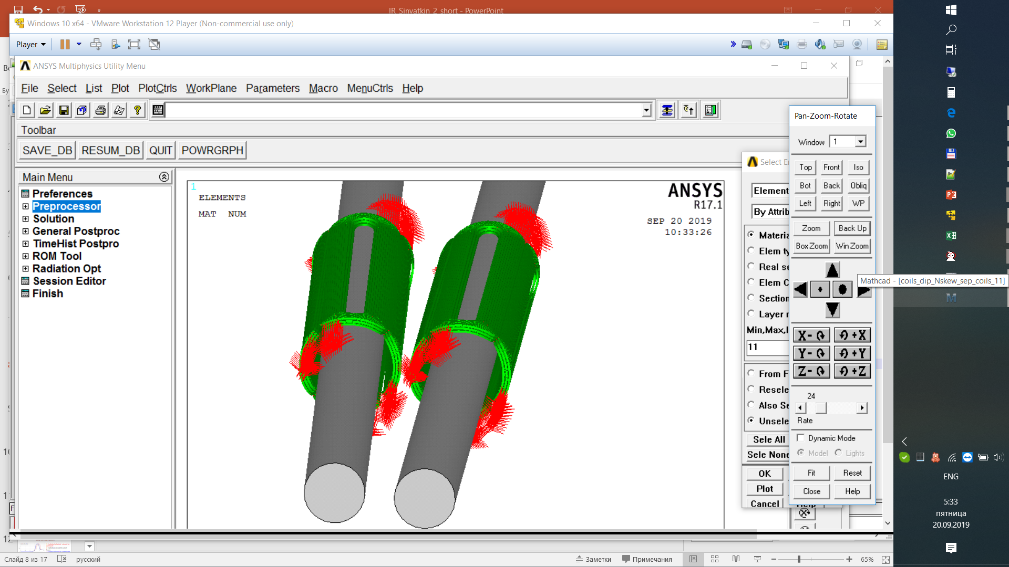
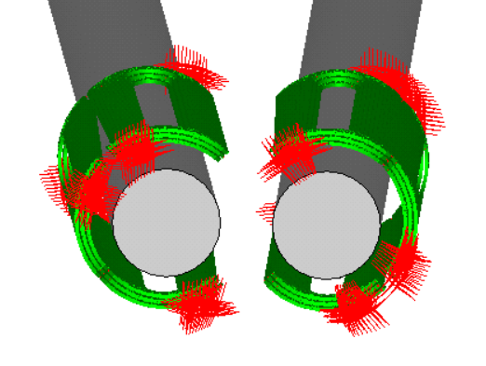
Compensating solenoid
-Elliptical for a both beams (3)
Dipole &
Skew quad corrections
At s = 0.62 m
At s = 0.84 m

Slide 22
Compensating solenoid
-Elliptical for a both beams (3)
Dipole &
Skew quad corrections
At s = 0.62 m
+I1
-I1
+I1
-I1
-I2
+I2
-I2
+I2
+I1
-I1
+I1
-I1
I1 = kb*Bx – kg*Gskew
I2 = 2*kb*Bx
Rharm = 10 mm

Slide 23
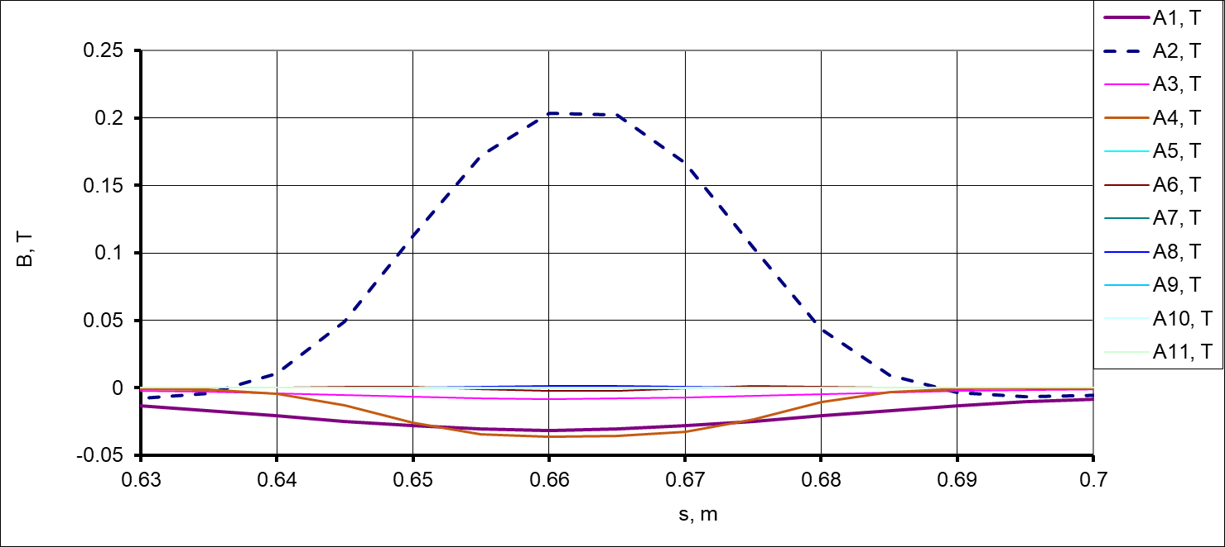
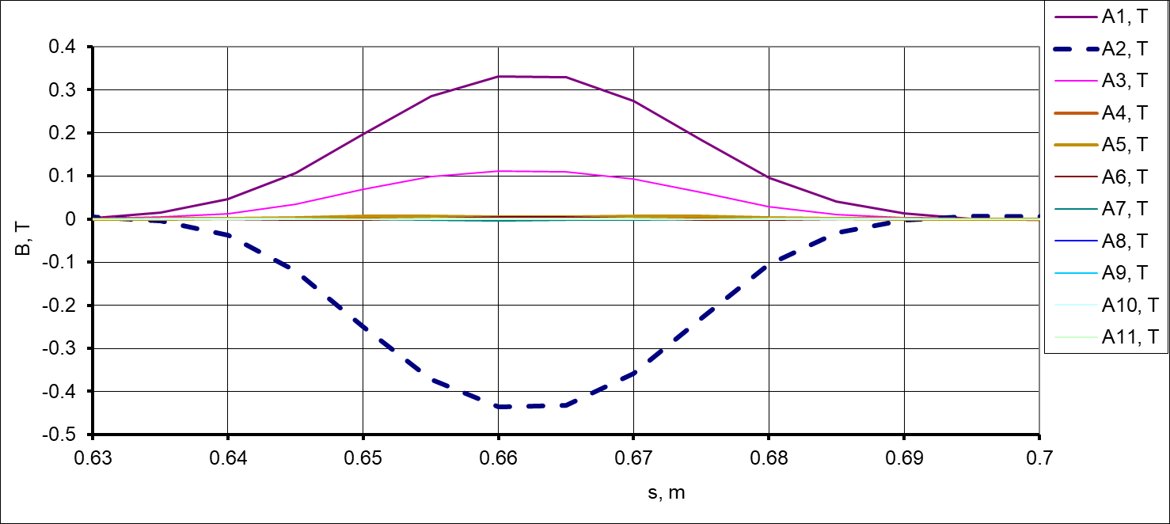
Compensating solenoid
-Elliptical for a both beams (Example)
Dipole &
Skew quad corrections
At s = 0.62 m
Bx = 0, Gskew ≠ 0
I1 =400 A
I2 = 0 A
Bx ≠ 0, Gskew = 0
I1 =-400 A
I2 = 800 A
I1 = kb*Bx – kg*Gskew
I2 = 2*kb*Bx
Rharm = 10 mm, Bn ≈ 0

Slide 24
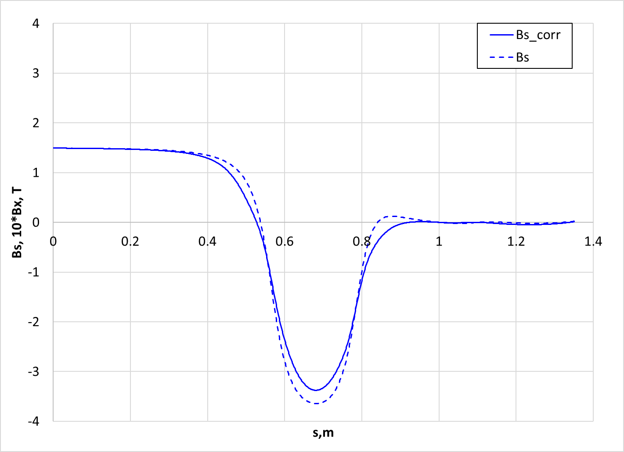
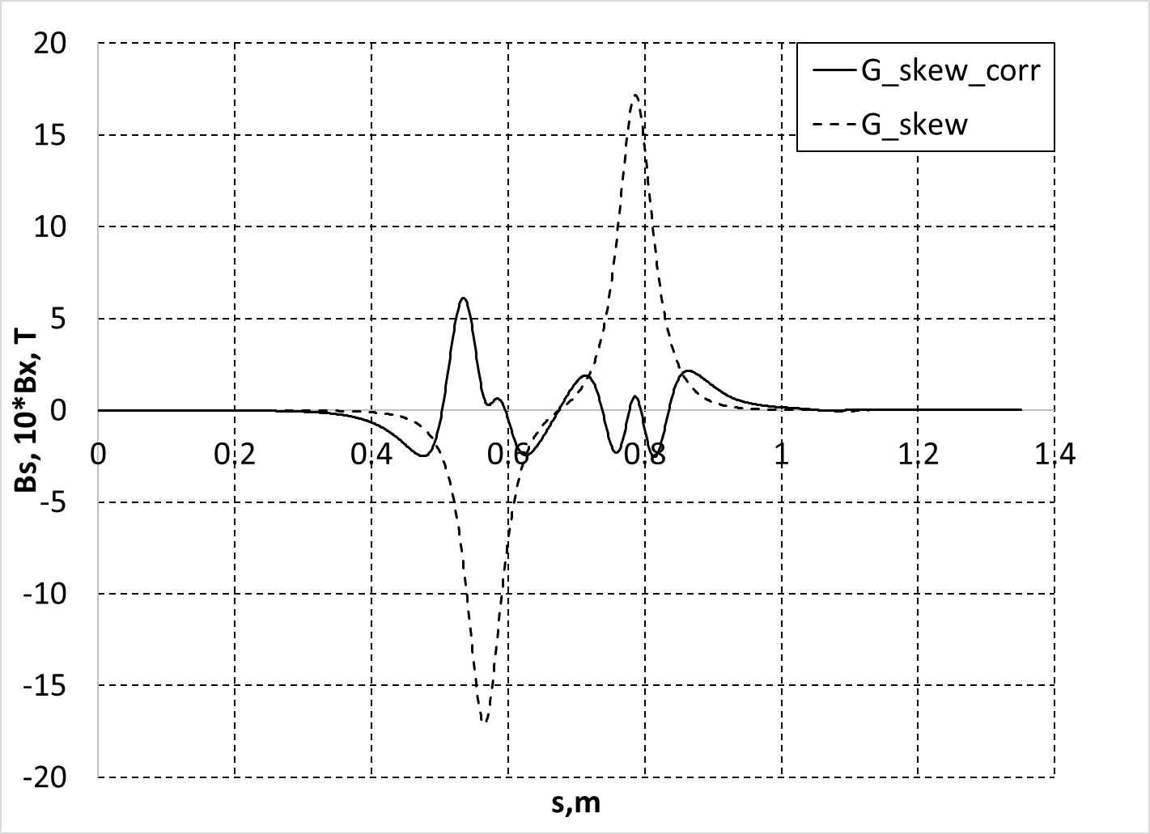
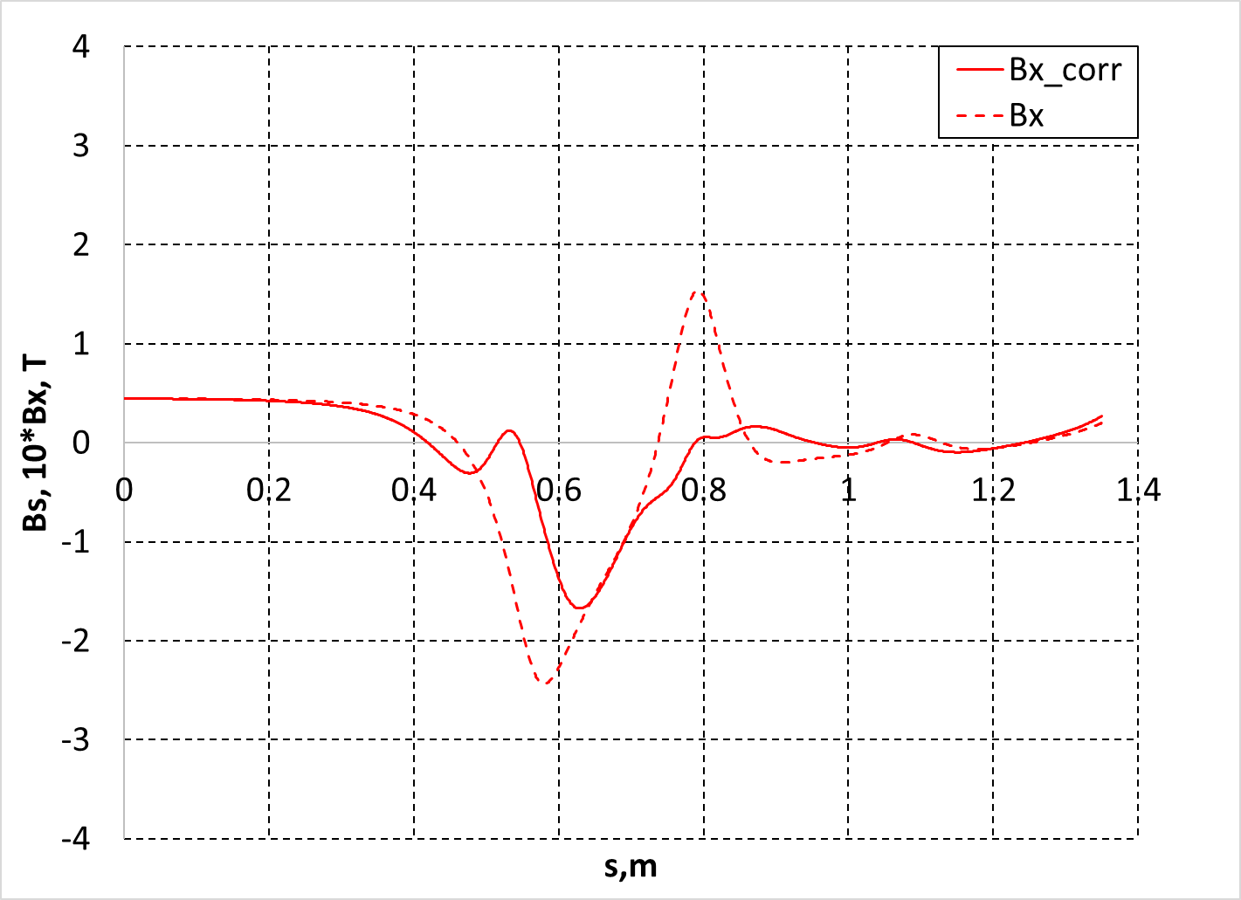
Distribution of magnetic field components
along reference trajectory
Elliptical solenoid for a both beams
Bx(0.9), T | 7.3E-05
Bs(0.9), T | 0.014
Gskew(0.9), T/m | 0.896

Slide 25
Distribution of magnetic field components
along reference trajectory
Elleptical solenoid for a both beams & correctors
Energy, GeV | 1
Qx | 27.548
Qy | 22.571
Ex, nm*rad | 1.20
Ey, nm*rad | 0.0005
Ey / Ex | 0.0004
Betx_IP, m | 0.050
alfx_IP | -0.00
Bety_IP, mm | 0.50
alfy_IP | 0.00
dx_IP, m | 4.9E-06
dy_IP, m | 0.000
IP
IP

Slide 26
Summary
The basic layout provides acceptable vertical emittance blow up.
Solenoidal magnetic fields in a quadrupole lens require additional correction.
New MDI design completely eliminates emittance blow up due to the horizontal field at the orbit and local betatron coupling (Δε_{y} <0.5 pm*rad).
The new scheme provides small magnetic fields in the quadrupoles area and additional room for other devices.
The new scheme has all accelerator components in 175 mrad cone.
Individual corrector coils can be used for hor/vert beam tuning at the IP.
Suppression of the orbit distortion and dispersion at IP requires additional correctors.
New scheme is more complicated.

