Slide 1
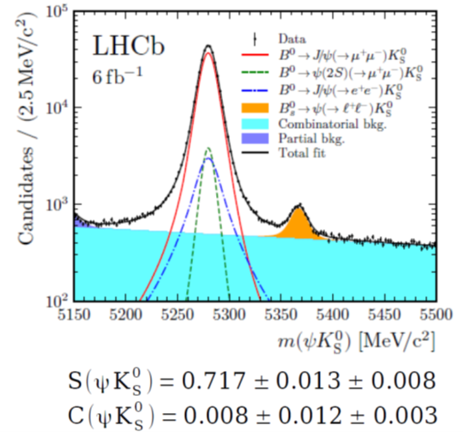
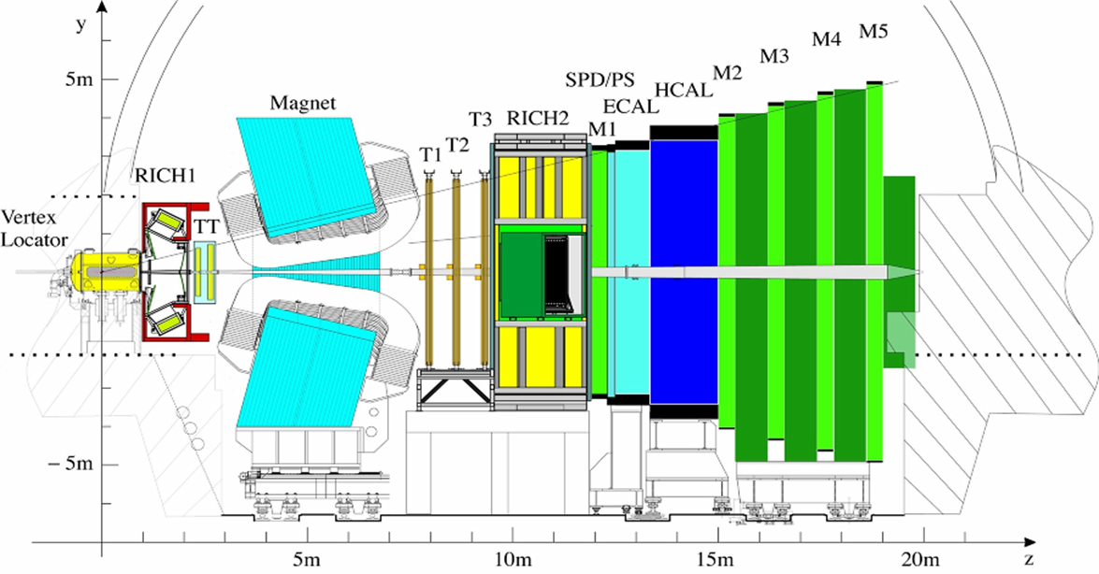
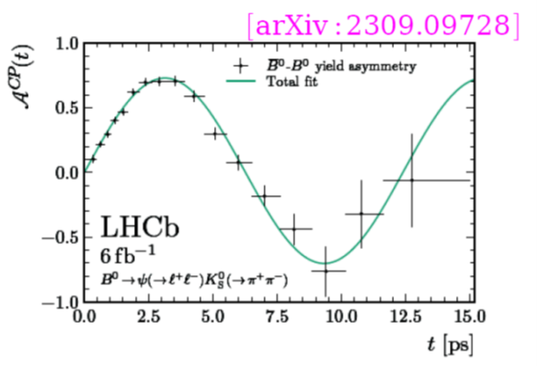
LHCb
Search for New Physics by studying rare processes and
precision CP violation measurements in B and D sectors
Good vertexing - Measure B_{d} /B_{s} oscillations, reject prompt background
Particle identification - Flavour tagging, misID background
Calorimetry - Reconstruction of neutral particles (γ, π⁰)
Efficient trigger, including hadronic modes

Slide 2
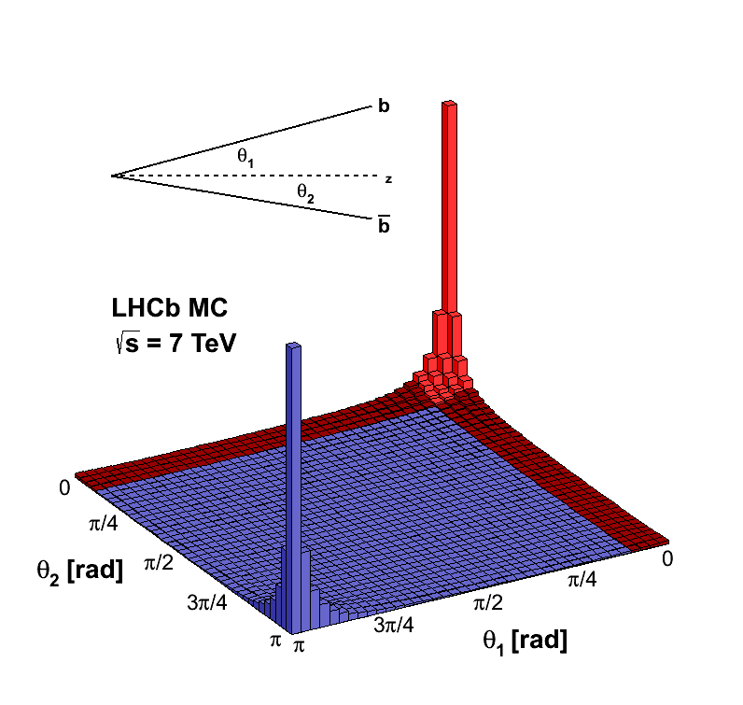
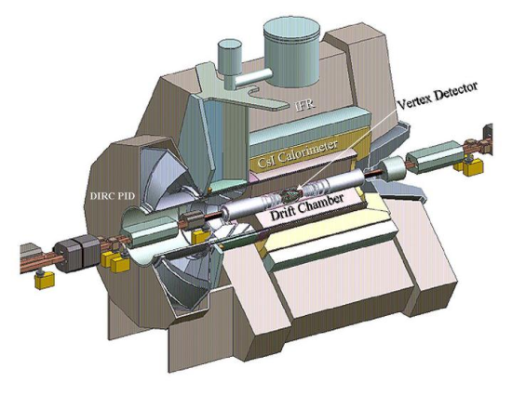
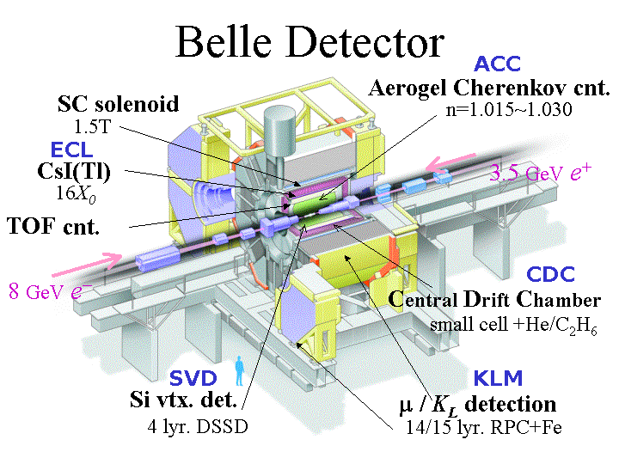
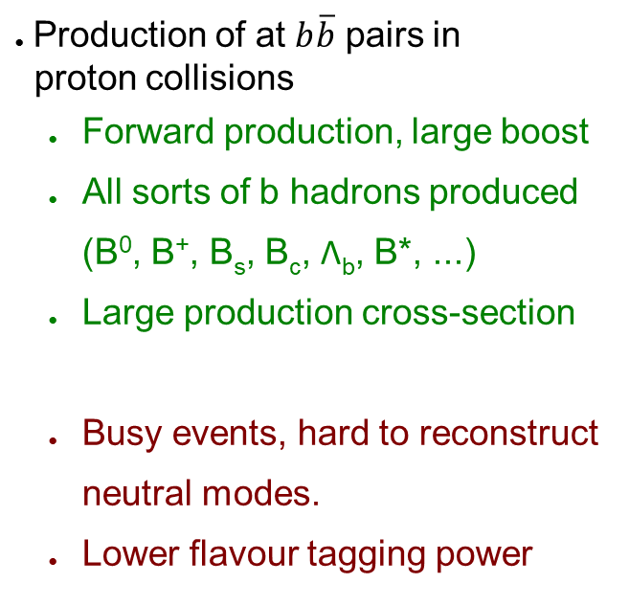
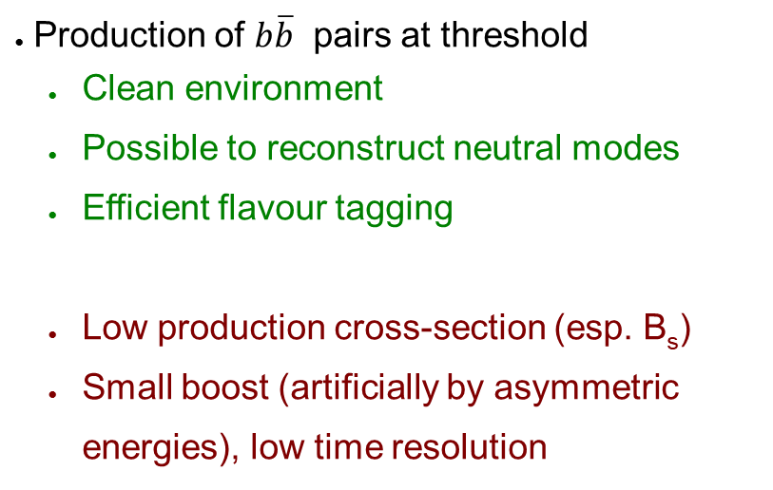
B physics at e⁺e⁻ and proton colliders
Electron-positron colliders (B factories)
Hadron colliders
Production of at $b\overline{b}$ pairs in
proton collisions
  Forward production, large boost
  All sorts of b hadrons produced
  (B⁰, B⁺, B_{s}, B_{c}, Λ_{b}, B*, ...)
  Large production cross-section
  Busy events, hard to reconstruct
  neutral modes.
  Lower flavour tagging power
BaBar (PEP-II, SLAC)
Belle (KEKB, KEK)
Production of $b\overline{b}$ pairs at threshold
  Clean environment
  Possible to reconstruct neutral modes
  Efficient flavour tagging
  Low production cross-section (esp. B_{s})
  Small boost (artificially by asymmetric
  energies), low time resolution

Slide 4
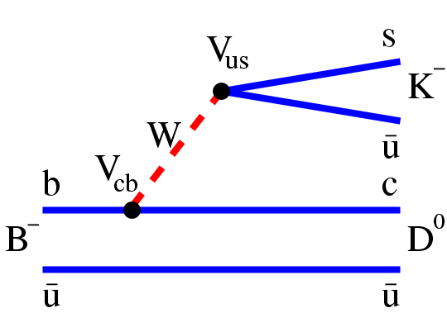
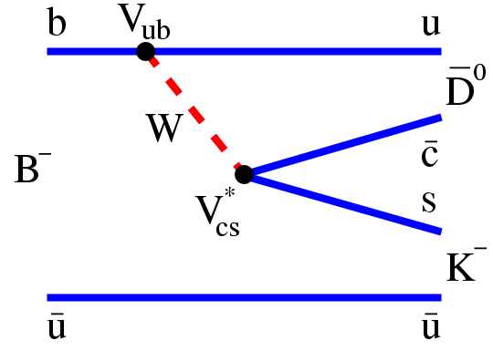





$$B^{−}→D^{0}K^{−}$$
CP violation enters the Standard Model as a complex phase ⇒ only observable in the interference. To measure γ, use interference on V_{ub} and V_{cb} amplitudes:
B–→D⁰K–: B–→D⁰K:
$$A_{1}\sim V_{cb}V_{us}^{∗}$$
$$A_{2}\sim V_{ub}V_{cs}^{∗}\sim Aλ^{3}(ρ−iη)\sim e^{−iγ}$$
Amplitudes interfere if D⁰ and D⁰ decay into the same final state
Relative phase: (B–→DK–), (B⁺→DK⁺)
includes weak (γ) and strong (δ) phase.
Magnitude of CP violation is determined by the ratio of the two amplitudes:
$$θ=−γ+δ$$
$$θ=γ+δ$$

Slide 5
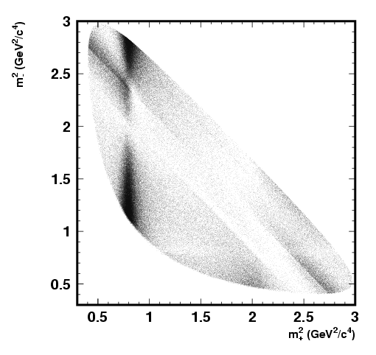
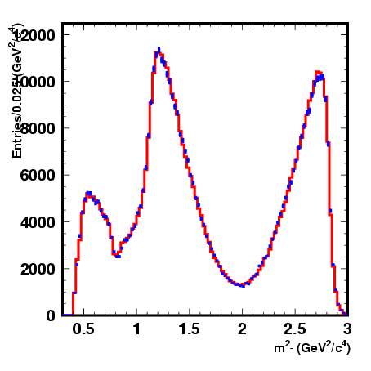
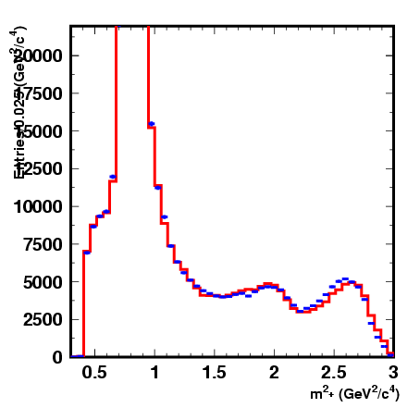
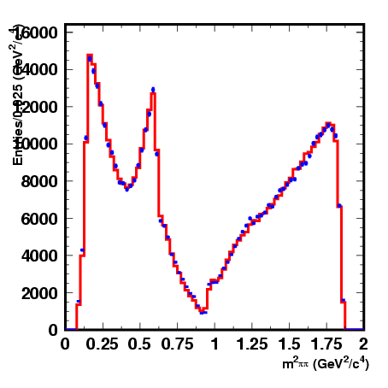
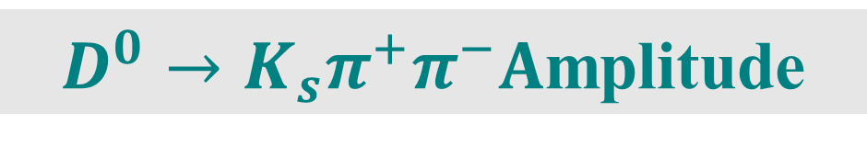

$D^{0}→K_{s}π^{+}π^{−}A$mplitude
Belle collaboration, 657M BB pairs [PRD81:112002,2010]
Isobar model is used as a baseline. K-matrix for systematics test.
$$D^{∗+}→D^{0}π^{+},D^{0}→K_{s}π^{+}π^{−}$$
Intermediate state
Amplitude
Phase, °
M (GeV ² )
K_{s}π –
K_{S} σ₁
K_{S} ρ(770)
K_{S} ω
K_{S} f₀(980)
K_{S} σ₂
K_{S} f₂(1270)
K_{S} f₀(1370)
K_{S} ρ(1450)
K* (892)⁺π–
K*(892)–π⁺
K*(1410)⁺π–
K*(1410)–π⁺
K*₀(1430)⁺π–
K*₀(1430)–π⁺
K*₂(1430)⁺π–
K*₂(1430)–π⁺
K*(1680)⁺π–
K*(1680)–π⁺
Nonresonant
1.56±0.06_{S}
1 (fixed)_{S}
0.0343±0.0008_{S}
0.385±0.006_{S}
0.20±0.02_{S}
1.44±0.04_{S}
1.56±0.12_{S}
0.49±0.08_{S}
1.638±0.010
0.149±0.004
0.65±0.05
0.42±0.04
2.21±0.04_{S}
0.36±0.03_{S}
0.89±0.03_{S}
0.23±0.02_{S}
0.88±0.27
2.1±0.2
2.7±0.3
214±3_{S}
0 (fixed)_{S}
112.0±1.3_{S}
207.3±2.3_{S}
212±12_{S}
342.9±1.7_{S}
110±4_{S}
64±11_{S}
133.2±0.4
325.4±1.3
120±4
253±5
358.9±1.1_{S}
87±4_{S}
314.8±1.1_{S}
275±6_{S}
82±17
130±6
160±5
²
σ₁(M=522±6 MeV, Γ=453±10 MeV)
σ₂(M=1033±7 MeV, Γ=88±7 MeV)

Slide 6
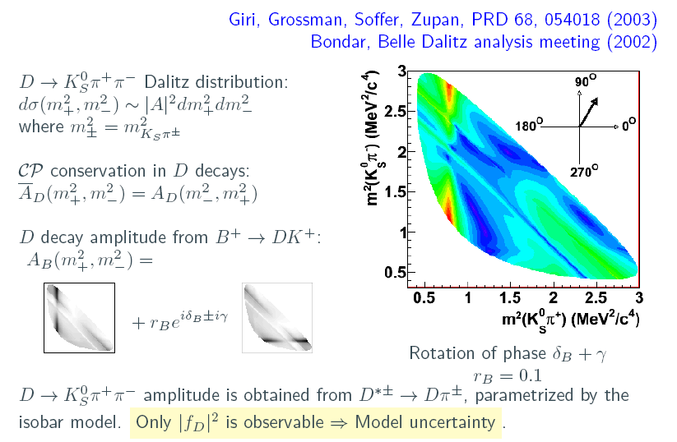
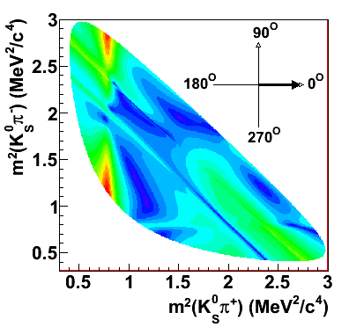
Dalitz Method

Slide 7
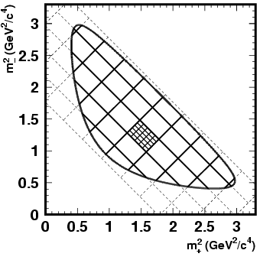


Model-independent Analysis
Number of events in D⁰-plot:
-i
Number of events in B-plot
i
Number of events in D_{CP}-plot
$$x_{±}=cos(δ_{B}±γ)$$
$$y_{±}=sin(δ_{B}±γ)$$
c_{i} , s_{i} can be obtained from B data (M_{i}) only
c_{i} from D_{CP}, s_{i} from B data
⇒ Very poor sensitivity
⇒ Poor sensitivity for y

Slide 8
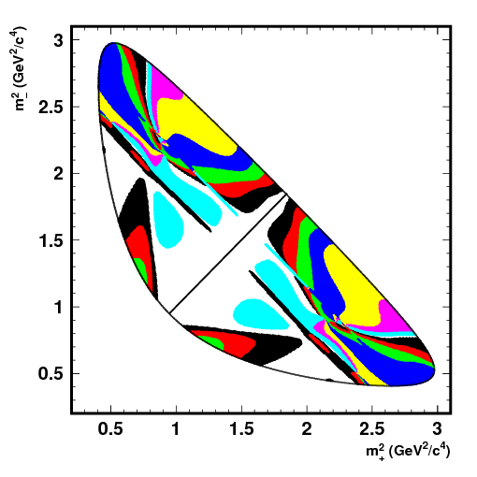
Model-independent Analysis
Find binning with optimal sensitivity
Get rid of bias due to
Satisfy simultaneously for
binning with
Good approximation:
uniform binning in Δδ_{D}
But the optimal binning depends on
D⁰ model. ⇒ bias if it differs from
the actual one (~10° by toy MC).
causes unavoidable
model sensitivity.
Reduces as data increases
(by applying finer binning).

Slide 9

Model-independent Analysis
Model-independent way:
obtain D⁰ decay strong phase from ψ(3770)→D$\overline{D}$ data
Free parameters
Unknown, can be obtained
from charm data at ψ(3770):
ψ(3770)‏
D_{CP}→K_{S}ω, K⁺K–, …
D_{CP}→K_{S}π⁺π–:
D_{CP}→K_{S}π⁺π–:
ψ(3770)→(K_{S}π⁺π–)_{D} (K_{S}π⁺π–)_{D} :

Slide 10
Model-independent Analysis
2 correlated Dalitz plots, 4 dimensions:
Can use maximum likelihood technique:
with c_{i} and s_{i} as free parameters.
For the same binning as in D_{CP}, number of bins is N² (instead of N),
but the number of unknowns is the same.
With Poisson PDF, it’s OK to have N_{ij}<1.
Can obtain both c_{i} and s_{i}.

Slide 11
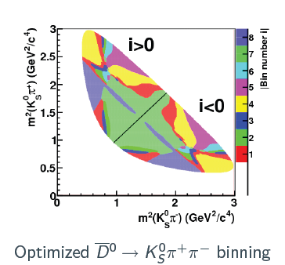
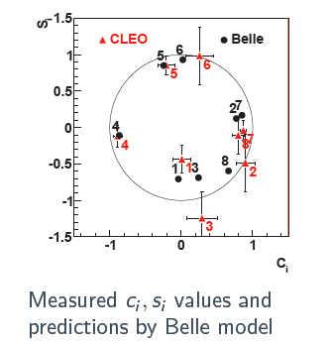
Model-independent Analysis
Introduce the binning of the phase space (i=-N, N). Number of events:
contains only the terms that can be obtained experimentally, does not depend on the amplitude structure inside the bin.
CLEO-c measurement: PRD 82 112006(2010).
Expect 2-3° contribution in γ accuracy

Slide 12

LHCb Angle $γ$ Measurement

Slide 14
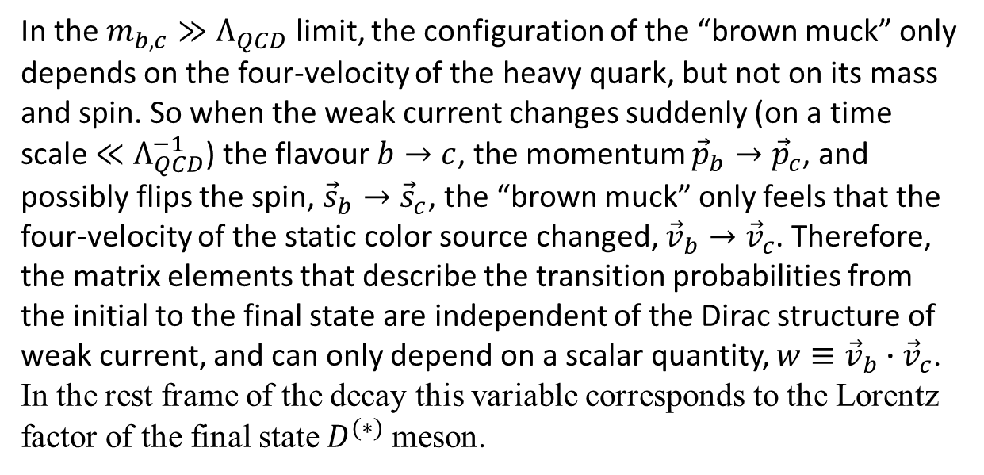
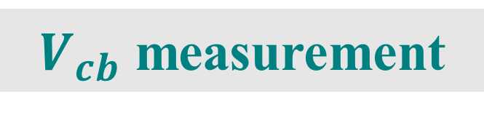
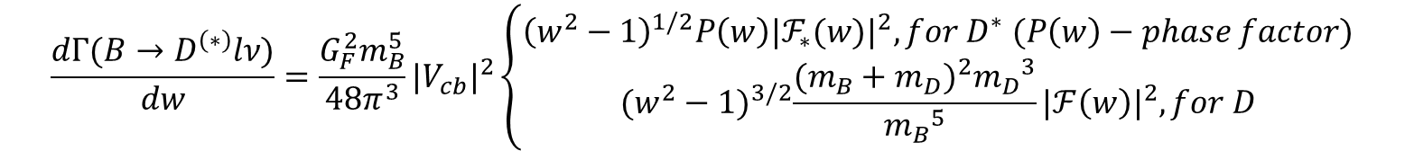
$V_{cb}$ measurement
In the $m_{b,c}≫Λ_{QCD}$ limit, the configuration of the “brown muck” only depends on the four-velocity of the heavy quark, but not on its mass and spin. So when the weak current changes suddenly (on a time scale $≪Λ_{QCD}^{−1}$) the flavour $b→c$, the momentum ${\vec{p}}_{b}→{\vec{p}}_{c}$, and possibly flips the spin, ${\vec{s}}_{b}→{\vec{s}}_{c}$, the “brown muck” only feels that the four-velocity of the static color source changed, ${\vec{v}}_{b}→{\vec{v}}_{c}$. Therefore, the matrix elements that describe the transition probabilities from the initial to the final state are independent of the Dirac structure of weak current, and can only depend on a scalar quantity, $w≡{\vec{v}}_{b}∙{\vec{v}}_{c}$. In the rest frame of the decay this variable corresponds to the Lorentz factor of the final state $D^{(∗)}$ meson.
The determination of $|V_{cb}|$ from $B→D^{(∗)}lν$ decays use ts to the decay distributions to measure the rates near zero recoil, $w=1$. The rates can be schematically written as
$$\frac{dΓ(B→D^{\left(∗\right)}lν)}{dw}=\frac{G_{F}^{2}m_{B}^{5}}{48π^{3}}{|V_{cb}|}^{2}\left\{\begin{aligned}{\left(w^{2}−1\right)}^{1/2}P\left(w\right){{|ℱ}_{∗}(w)|}^{2},for D^{∗} (P\left(w\right)−phase factor) \\ {(w^{2}−1)}^{3/2}\frac{{(m_{B}+m_{D})}^{2}{m_{D}}^{3}}{{m_{B}}^{5}}{|ℱ\left(w\right)|}^{2},for D\end{aligned}\right.$$
Both $ℱ(w)$ and $ℱ_{∗}(w)$ are equal to the Isgur-Wise function in the $m_{Q}→∞$ limit, and $ℱ_{\left(∗\right)}\left(1\right)=1$ is the basis for a model-independent determination of $|V_{cb}|$.

Slide 15
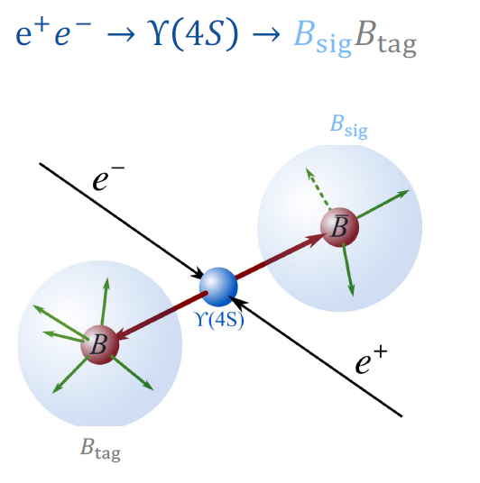
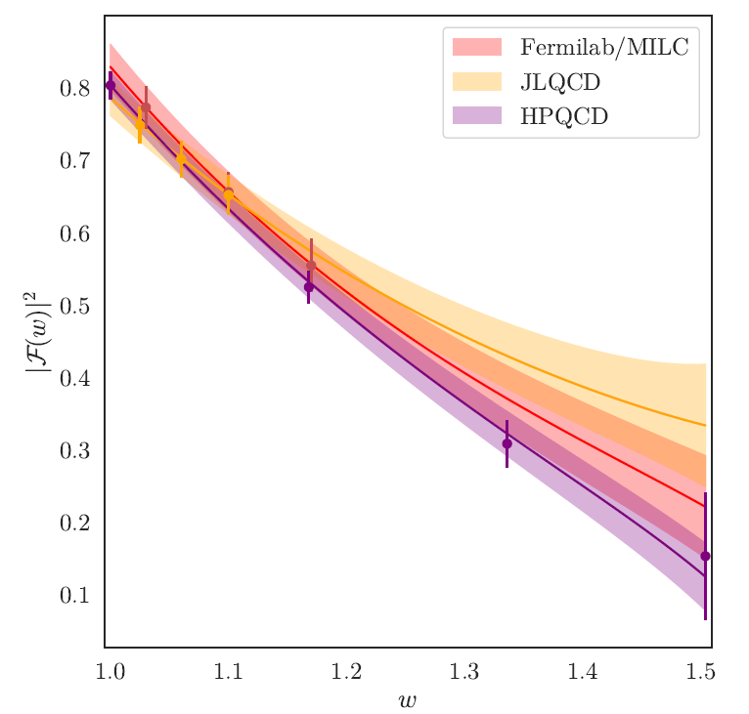


$V_{cb}$ exclusive measurement
Belle II, Phys.Rev.D 108 (2023) 1, 012002
l
$$D^{(∗)}$$
Use Full Event Interpreter to reconstruct $B_{tag}$
Reconstruct $B→D^{(∗)}lν$ with $D^{∗+}→D^{0/+}π^{+/0}$and $D^{∗0}→D^{0}π^{0}$
Missing mass squared: $M_{miss}^{2}={(p_{e^{+}e^{−}}−p_{B_{tag}}−p_{D^{∗}}−p_{l})}^{2}$
$$\left|V_{cb}\right|=(40.6±0.9)×{10}^{−3}$$

Slide 16
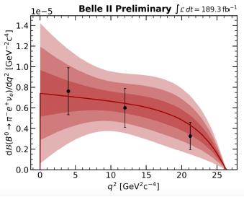
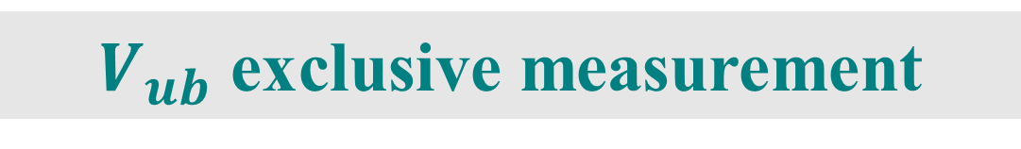
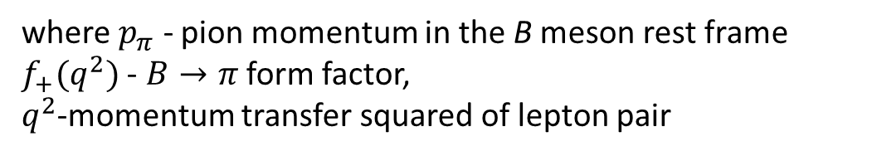
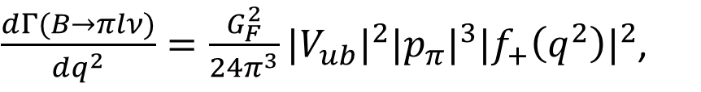
$V_{ub}$ exclusive measurement
Belle II, 2206.08102
$\frac{dΓ(B→πlν)}{dq^{2}}=\frac{G_{F}^{2}}{24π^{3}}{|V_{ub}|}^{2}{|p_{π}|}^{3}{|f_{+}\left(q^{2}\right)|}^{2}$,
where $p_{π}$ - pion momentum in the B meson rest frame $f_{+}(q^{2})$ - $B→π$ form factor, $q^{2}$-momentum transfer squared of lepton pair
Use Full Event Interpreter to reconstruct $B_{tag}$
Reconstruct $B→πlν,$ $q^{2}={(p_{e^{+}e^{−}}−p_{B_{tag}}−p_{π})}^{2}$
Missing mass squared: $M_{miss}^{2}={(p_{e^{+}e^{−}}−p_{B_{tag}}−p_{π}−p_{l})}^{2}$
$$\left|V_{ub}\right|=(3.88±0.45)×{10}^{−3}$$

Slide 17
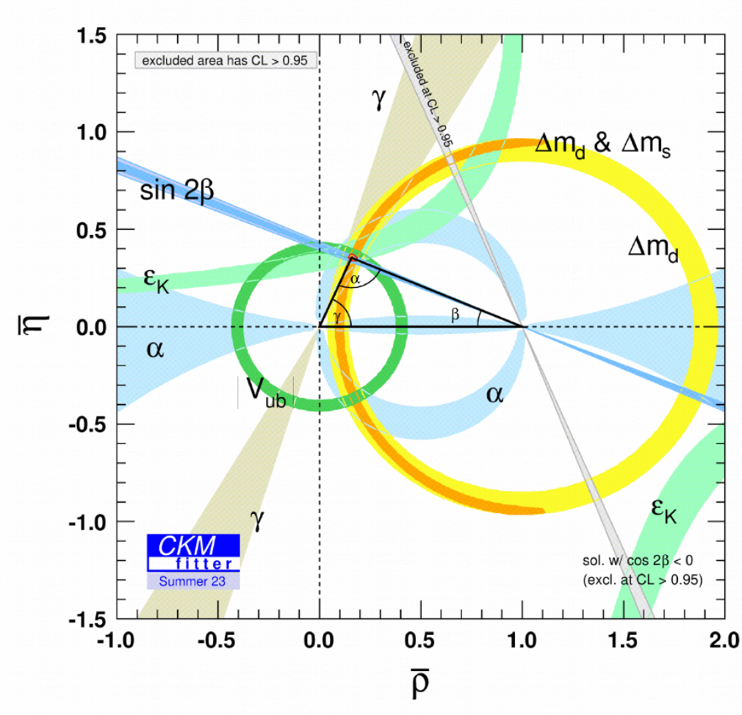

Slide 19
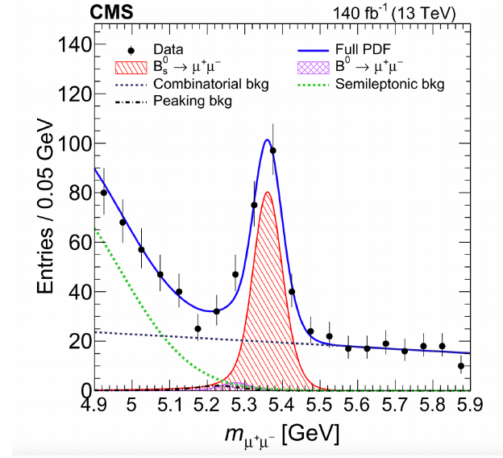


Slide 21
Instead of Conclusion
Summer 2035?
Summer 2023

